Slide 1
Computer Architecture 1 Introduction to Parallel Architectures
Keio University
AMANO, Hideharu
hunga@am．ics．keio．ac．jp
Notes:
Thank you for taking this class; Special Course of Computer Architecture. This class focuses on a class of computers: parallel computers.
Recently most of the computers have been parallel computers. So, this course treats a wide are of computers. My name is Amano.
Today, we have the first lesson which introduces parallel computer architecture.

Slide 2
Parallel Architecture
A parallel architecture consists of multiple processing units which work simultaneously.
→ Thread level parallelism
Multi-core revolution
Purposes
Important concepts
Classifications
Terms
Notes:
The definition of parallel architectures is simple. A computer that consists of multiple processing units working simultaneously. It make the use of thread level parallelism explained later.
Today, I will talk on …

Slide 3
Boundary between Parallel machines and Uniprocessors
Uniprocessors
ILP(Instruction Level Parallelism)
A single Program Counter
Parallelism Inside/Between instructions
TLP(Thread Level Parallelism)
Multiple Program Counters
Parallelism between threads and jobs
Parallel Machines
Definition
Hennessy & Petterson’s
Computer Architecture: A quantitative approach
Notes:
First, this slide shows the boundary between parallel machines and uniprocessors.
Every computer uses parallel execution mechanism, but uniprocessors use ILP or instruction level parallelism.
That is, there is only a single program counter, and the parallelism inside or between instructions is utilized.
On the contrary, parallel machines use mainly the TLP or thread level parallelism. There are multiple program
counters, and parallelism between processes, tasks or threads sometimes jobs are utilized.

Slide 4
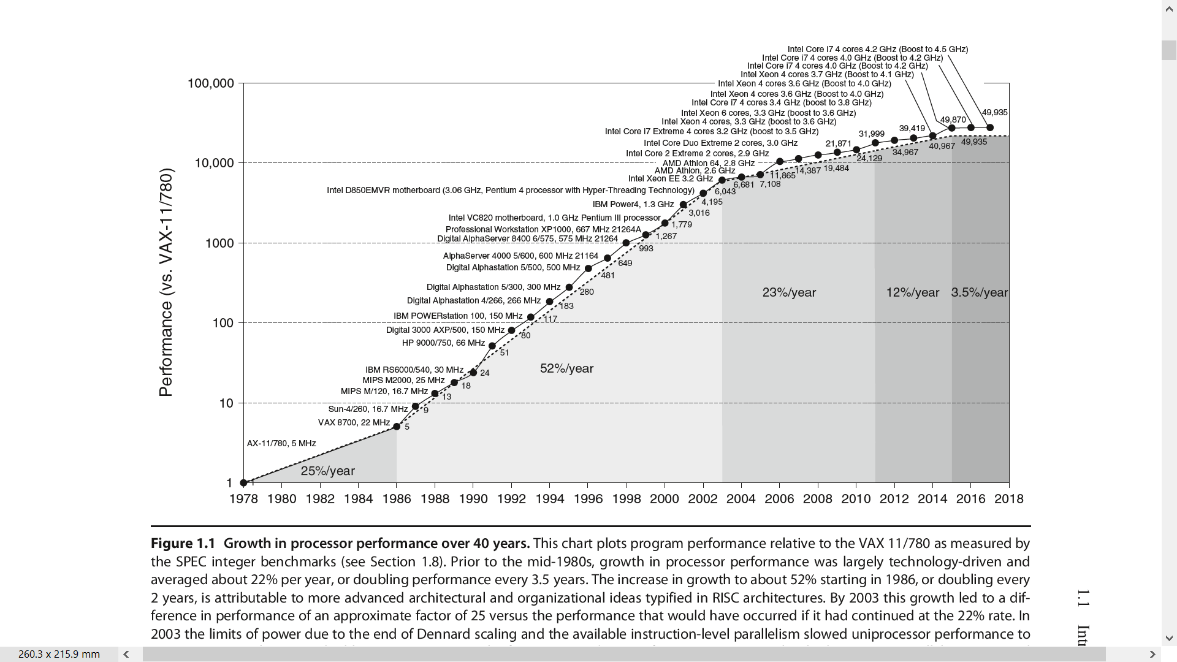
Uniprocessor Performance improvement of uniprocessors
Hennessy & Patterson “Computer Architecture a quantitative approach 6th Edition"
Notes:
Parallel architectures have become popularly used from 2003 or 2004. This diagram shows how the relative performance has been improved year by year. Note that the vertical axis uses a log-scale. From 1986, the performance of uniprocessors was improved 57% per year. It means that the performance was doubled for every 18 months. It is sometimes called Moore’s Low. But, from 2003, the performance improvement was suddenly decayed and this tendency has been kept now. From 2003, Intel and other computer makers changed their policy to increase the number of processors or cores in a chip rather than improving the performance of each processor. That is, the multi-core revolution happened at that time.

Slide 5
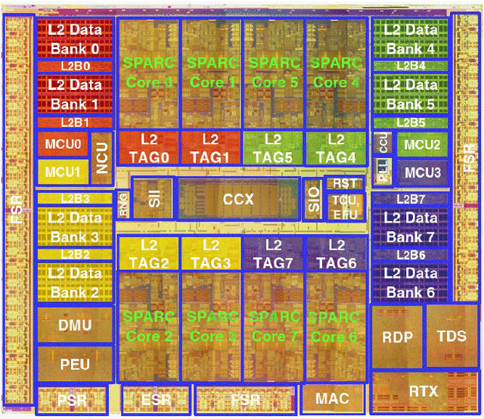
Multicore Revolution
The end of increasing clock frequency
Consuming power becomes too much.
A large wiring delay in recent processes.
The gap between CPU performance and memory latency
The limitation of ILP
Since 2003, almost every computer
became multi-core.
Even smartphones use 2-8-core.
Now, except forsmall micro-controllers,
every computer is a parallel computer.
Niagara 2
Notes:
OK. but why the computer makers changed their policy. There were mainly three reasons. First increasing clock frequency became difficult. Since the power consumption is proportional to the clock frequency, at that time, the power consumption of a single processor reached more than 100W. It means that a large heat sink and fun were needed. Also, the operational speed of semiconductor was saturated. The performance of the transistors was still improved, but the total frequency was limited with a wiring delay. If you designed a large processor, it was difficult to keep the performance.
Then, there was also a problem called Memory Wall. That is, the memory performance was also saturated, and if the CPU performance was improved, the total performance might not increases because of memory bottleneck.
Another reason is the limitation of Instruction Level Parallelism. Until 2003, various types of techniques have been invented, but the instruction level parallesim to be used reached a limitation.
For these reasons, since 2003, almost every computer became multi-core, and now even smartphones use from 2 to 8-core processors. Now, except for small micro-controllers, every computer is a parallel computer.

Slide 6
Purposes of providing multiple processors
Performance
A job can be executed quickly with multiple processors
Dependability
If a processing unit is damaged, total system can be available： Redundant systems
Resource sharing
Multiple jobs share memory and/or I/O modules for cost effective processing：Distributed systems
Low energy
High performance even with low frequency operation
Notes:
There are several benefit to have multiple processors…. The last one, low energy computing will need further explanation.

Slide 7
Low Power by using multiple processors
n X performance with n processors,
but the power consumption is also n times.
If so, multiple processors do not contribute at all.
P_{dynamic} ∝ Vdd² × f
f_{max} ∝ Vdd
If n processor achieves n times performance, f_{max} can be 1/n. → Vdd can be lowered. → P_{dynamic} can be lowered in squire order.
Of course, the fmax is not linearly related to Vdd.
_{Vdd has some limitation.}
Notes:
It seems strange that low power computing is achieved by using multiple processors. If we use n processors, we can achieve n times performance at maximum, but the power consumption becomes also n times. Thus, multiple processors do not contribute for low power at all. However, note that the dynamic power is proportional to Vdd, the supply voltage square and operational frequency f. Also, the operational frequency f is proportional to Vdd in a certain range, it means that if we want to use high frequency the supply voltage must be high. Here, if we can achieve n times performance with n processors, we can lower the Vdd to achieve the same performance. Since dynamic power is proportional to Vdd squire, we can much lower the total power consumption. Of course the maximum frequency is not proportional to very low Vdd, this theory cannot be established ideally. But, parallel processing is still useful for low power computing.

Slide 8
Quiz
Assume a processor which consumes 10W with 1.8V Vdd and 3GHz clock.
You can improve performance by 10x with 10 processors, it means that the same performance can be achieved with 300MHz clock.
In this case, Vdd can be 1.0V.
How much power does the machine with 10 processors consume?

Slide 9
Parallelism in a target application
For high speed execution of a single job
TLP: Tｈread(Task）-level parallelism: a job is divided into threads executed in parallel by a compiler/programmer.
DLP: Data-level parallelism: an operation is applied to a lot of data in parallel.
RLP: Request Level Parallelism
Execution of multiple-jobs independent from each other.
Easy to execute in parallel.
Request level parallelism?
→Data centers treat such parallelism

Slide 10
Overhead of parallel execution
The limitation of parallelism
Strong scaling vs. weak scaling
Load balancing
Processor with heavy load becomes bottleneck.
The loss of synchronization and data exchange
Notes:
Overhead is required for parallel execution. First there is the limitation of parallelism. A program cannot be executed completely in parallel.
If strong scaling is used, this limitation becomes severe.
Second, the computational load cannot always distributed evenly. If load balancing is not kept, the processor with heavy load becomes bottleneck.
Load balancing is important problem, but in this lesson, I will skip this issue, since it is not in a field of computer architectures.
Third, the time for synchronization and data exchange is added to the execution time. In this lesson, I will introduce the efficient synchronization method and high speed interconnection network in this lesson.
Today, I will explain about the first issue.

Slide 11
Amdahl’s law
Serial part
１％
Parallel part 99％
Accelerated by parallel processing
0.01 + 0.99/p
50 times with 100 cores、91 times with 1000 cores
If there is a small part of serial execution part, the performance
improvement is limited.
→The total task is fixed: Strong Scaling
Notes:
May be most of you know of the famous Amdahl’s law. The portion which can apply the enhancement method limits the total performance enhancement. Assume that there is only one percent of the job which cannot be executed in parallel, and the other 99% is completely parallel executable. In this case, if we execute it with 100 cores, 50 times performance improvement is obtained. But if we use 1000 cores only 91 times performance improvement is achieved. That is, the performance improvement never beyond 100 times even with infinite number of cores.
The performance measurement with a fixed task is called strong scaling. When we use strong scaling, a large size parallel machine is hopeless.

Slide 12
Weak scaling
A large supercomputer with a lot of processors will treat a large scale program.
The task for a processor is fixed→Weak scaling
If the ratio of serial computing becomes 1/p by treating large program size:
p=10: 1% x9.17
p=100: 0.1% x90.81
p=10000: 0.001% x9090.9
Notes:
However, in reality, supercomputers with huge number of cores have been developed. Why? Because they are mainly used for a large scale program for its scale. When the task for a each processor is fixed, it is called weak scaling. Generally, the portion of parallel execution part becomes large for larger problems. If the ration of serial computing part becomes 1/p by treating large program size, the performance keeps improving. Some people feels that the weak scaling is unfair. But, it is used for supercomputers which treat only huge scale problems.

Slide 13
glossary 1
Simultaneously: 同時に、という意味でin parallelとほとんど同じだが、ちょっとニュアンスが違う。in parallelだと同じようなことを同時にやる感じがするが、simultaneouslyだととにかく同時にやればよい感じがする。
Thread: プログラムの一連の流れのこと。Thread level parallelism（TLP)は、Thread間の並列性のことで、ここではHennessy and Pattersonのテキストに従ってPCが独立している場合に使うが違った意味に使う人も居る。これに対してPCが単一で命令間にある並列性をILPと呼ぶ
Dependability: 耐故障性、Reliability(信頼性）, Availability(可用性）双方を含み、要するに故障に強いこと。Redundant systemは冗長システムのことで、多めに資源を持つことで耐故障性を上げることができる。
Distributed system:分散システム、分散して処理することにより効率的に処理をしたり耐故障性を上げたりする

Slide 14
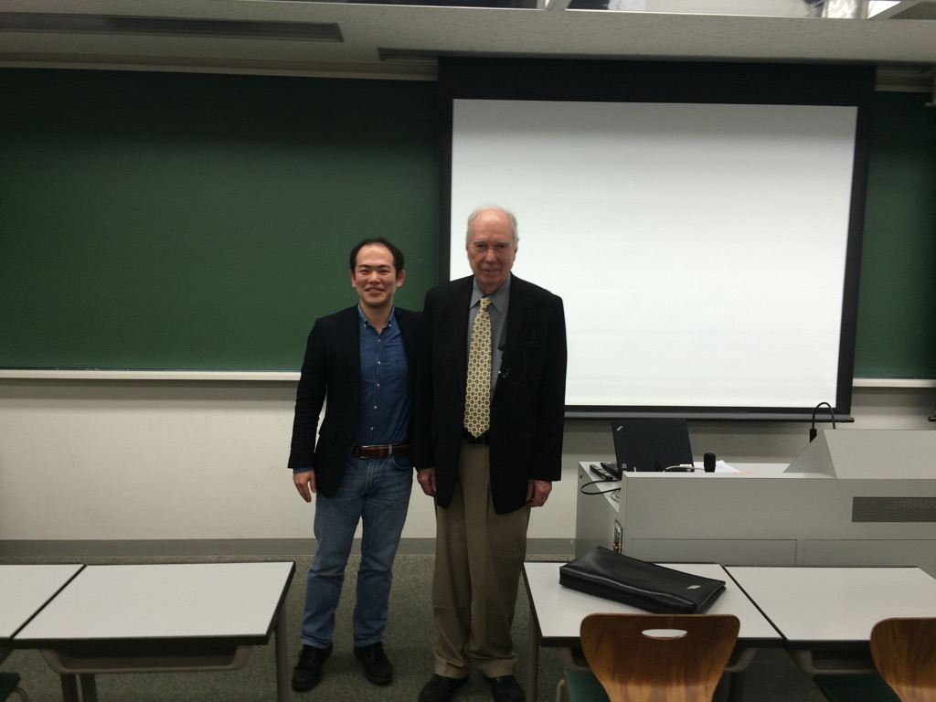
Flynn’s Classification
The number of Instruction Stream： M(Multiple)/S(Single)
The number of Data Stream：M/S
SISD
Uniprocessors（including Super scalar、VLIW）
MISD： Not existing（Analog Computer）
SIMD
MIMD
He gave a lecture at Keio
several times.
Notes:
Let me move to the next section. The classification. First of all. I will talk about Flynn’s classification. Professor Flynn is still a full professor of Stanford University U.S.A. He is very aged man, but still active duty. In United State, if Professors are successful in business and hire themselves, they can be active duty after the retirement age. He was successful to start a venture company Maxceller and may be he will work as he like. He likes Japan and sometimes comes and makes a lecture here in Keio University. He proposed famous Flynn’s classification which classifies computers with the number of instruction stream and data stream in 1979. SISD is just a uniprocessor. MISD is treated as non-existing machines. So, SIMD and MIMD are frequently used words.

Slide 15
SIMD (Single Instruction Stream Multiple Data Streams
All Processing Units executes the same instruction
Low degree of flexibility
GPU falls into SIMD.
Instruction
Memory
Instruction
Processing Unit
Data memory
Notes:
Single Instruction Stream Multiple Data Streams or SIMD executes a single instruction with a lot of processing units together. Each processing unit has its own data memory and according to the instruction fetched from the instruction memory, all execute the same operation. The advantage of SIMD is its simple structure and it is suitable to DLP. The problem is low degree of flexibility. The performance sometimes severely degraded if some of processors want to execute different operations from others. The GPU(Graphic Processing Unit) falls into this category.

Slide 16
GPU in a PC
DVD driver
Power
GPU
CPU
Memory
Notes:
Graphic Processing Unit or GPU is used most of personal computers. The unit is pushed into a slot of mother board as shown this photo.

Slide 17
GPU(Graphics Processing Unit)
NVIDIA Quadro
Notes:
This GPU is NVIDIA’s Quadro. It is rather dedicated machine for graphics processing. However, GPU can be used for wide application. The general purpose processing with GPU is called GPGPU.

Slide 18
T.Baji, CoolChips 2019 Keynote Speech
Notes:
This slide is by Toru Baji-san of NVIDIA in his keynote speech in 2019 CoolChips. GPU enjoyed the advance of semiconductors and increased the number of cores. Now, more than 5000 cores are embedded in a chip.

Slide 19
GPU is not just a simple SIMD.
A mixture of SIMD/MIMD/Multithread
GeForce
GTX280
240 cores
Host
Input Assembler
Thread Execution Manager
Thread Processors
Thread Processors
Thread Processors
Thread Processors
Thread Processors
…
PBSM
PBSM
PBSM
PBSM
PBSM
PBSM
PBSM
PBSM
PBSM
PBSM
Load/Store
Global Memory
Notes:
In GPU, a lot of cores called CUDA-core works with a single instruction, but it is not a simple SIMD machine. The techniques of MIMD machines and multithreading are used. Now GPU is a most frequently used accelerator for supercomputers. Also it is a key device for AI application and even for automatic driving control.
I will introduce this architecture later in this class.

Slide 20
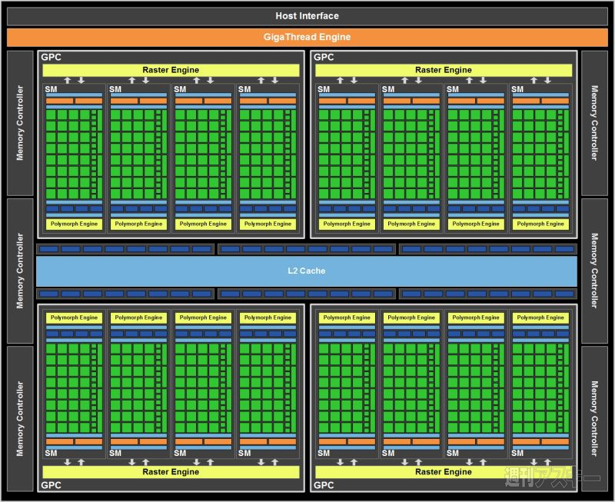
GPU(NVIDIA’s GTX580)
128 Cores
128 Cores
L2 Cache
128 Cores
128 Cores
512 GPU cores ( 128 X 4 )
768 KB L2 cache
40nm CMOS 550 mm^2
Notes:
This photo shows the chip layout of NVIDIA’s GPU. You can see that a large area of the chip is occupied with cores.

Slide 21
MIMD
Each processor executes individual instructions
Synchronization is required
High degree of flexibility
Various structures are possible
Processors
Interconnection
networks
Memory modules (Instructions・Data）
Notes:
Unlike SIMD, MIMD fetches individual instructions and execute them. For parallel processing, synchronization is required. Since it is a straight forward extension of the uniprocessor, most of PCs, servers, and even smartphones are MIMD machines.

Slide 22
Classification of MIMD machines Structure of shared memory
UMA(Uniform Memory Access Model）
provides shared memory which can be accessed from all processors with the same manner.
NUMA(Non-Uniform Memory Access Model）
provides shared memory but not uniformly accessed.
NORA/NORMA（No Remote Memory Access Model）
provides no shared memory. Communication is done with message passing.
Notes:
MIMD machines are further classified with their structure of shared memory. UMA, NUMA and NORA or NORMA.

Slide 23
UMA
The simplest structure of shared memory machine: Shared memory can be accessed evenly.
→ Centralized shared memory.
The extension of uniprocessors
OS which is an extension for single processor can be used.
Programming is easy→OpenMP
System size is limited.
The total system is implemented on a single chip.
On-chip multiprocessor
Chip multiprocessor
Single chip multiprocessor→ Multicore
Most of PCs and smartphones fall into UMA.
Notes:
UMA has the simplest structure of shared memory machine. It provides shared memory which can be accessed by all PEs evenly. That is, it provides centralized shared memory.
It is a straight forward extension of uniprocessors, and operating systems are also extensions of uniprocessors. Parallel programming is easy to be done for example, OpenMP. This will be introduced in this class. The problem of this style is that the size of the system is limited because of the congestion of the centralized shared memory. So, it is used in small systems. Usually, the total system is implemented on a single ship. Such UMA is called Multicore. Most of PCs, tablets and smartphones fall into UMA.

Slide 24
An example of UMA：Bus connected
Note that it is a logical image
L2 Cache
shared bus
Snoop
Cache
Snoop
Cache
Snoop
Cache
Snoop
Cache
PE
PE
PE
PE
Notes:
This is a common diagram of UMA. Of course, the shared bus is logical one. Inside the chip, it is built with a type of switch. The snoop cache is used in this type UMA. I will explain this technique later in this class.

Slide 25
MPCore (ARM+NEC)
Private
FIQ Lines
SMP for Embedded
application
…
Interrupt Distributor
Timer
CPU
interface
Timer
CPU
interface
Timer
CPU
interface
Timer
CPU
interface
Wdog
Wdog
Wdog
Wdog
IRQ
IRQ
IRQ
IRQ
CPU/VFP
CPU/VFP
CPU/VFP
CPU/VFP
L1 Memory
L1 Memory
L1 Memory
L1 Memory
Snoop Control Unit (SCU)
Coherence
Control Bus
Private
Peripheral
Bus
Duplicated
L1 Tag
Private
AXI R/W
64bit Bus
L2 Cache
Notes:
This shows an example of UMA for embedded usage. Four CPU share the L2 cache outside the chip.

Slide 26
Switch connected UMA:SUN T1
Core
L2
Cache
bank
Core
Directory
Crossbar
Switch
Core
L2
Cache
bank
Memory
Core
Directory
Core
L2
Cache
bank
Core
Directory
Core
FPU
L2
Cache
bank
Core
Single issue six-stage pipeline
RISC with 16KB Instruction cache/
8KB Data cache for L1
Directory
Total 3MB, 64byte Interleaved
Notes:
In order to increase the number of cores, a crossbar switch is used instead of the shared bus. However, this structure has the problem for cache coherence, if shared bus is not provided. I will explain on techniques for such machines.

Slide 27
Multi-Core (Intel’s Nehalem-EX)
CPU
L3 Cache
CPU
CPU
CPU
CPU
L3 Cache
CPU
CPU
CPU
8 CPU cores
24MB L3 cache
45nm CMOS 600 mm^2
Notes:
This photo is a UMA system with eight CPUs. Compared with GPU, you can see that the area of cache memory is larger than that for cores.

Slide 28
NUMA
Each processor provides a local memory, and accesses other processors’ memory through the network.
Address translation and cache control often make the hardware structure complicated.
Scalable：
Programs for UMA can run without modification.
The performance is improved as the system size.
Notes:
In NUMA, each processor provides a local memory, and accesses other processors’ memory through the network. So, it is sometimes called a distributed shared memory machine. Although the address translation and cache control often make the hardware structure complicated, the benefit is that it is scalable.

Slide 29
Typical structure of NUMA
Node ０
０
Node １
１
Ｉｎｔｅｒｃｏｎｎｅｃｔｏｎ
Ｎｅｔｗｏｒｋ
２
Node 2
３
Node ３
Logical address space
Notes:
This diagram shows the typical structure of NUMA. All PEs have their own local memory and accessed directly. These memory modules are mapped on to the same address space, so each PE can access the memory attached to the different PEs just accessing the different address. But in this case, request and data are transferred through the network. Of course, the access speed of local and distant memory is different. The same program as UMA can work, but if there are a lot of distant access, the performance is degraded.

Slide 30
Classification of NUMA
Simple NUMA：
Remote memory is not cached.
Simple structure but access cost of remote memory is large.
CC-NUMA：Cache Coherent
Cache consistency is maintained with hardware.
The structure tends to be complicated.
COMA:Cache Only Memory Architecture
No home memory
Complicated control mechanism
Notes:
NUMA is classified into Simple NUMA, CC-NUMA and COMA.

Slide 31
Supercomputer 「K」
Memory
L2 C
Core
Core
Tofu Interconnect
6-D Torus/Mesh
Core
Core
Inter
Connect
Controller
Core
Core
Core
Core
SPARC64 VIIIfx Chip
RDMA mechanism
NUMA or UMA+NORMA
4 nodes/board
96nodes/Lack
24boards/Lack
Notes:
Simple NUMA is useful for supercomputers because of its scalability. Japanese flagship supercomputers use this style to be used by various kind of users. This shows the node structure of Supercomputer K. UMA chip is connected to others through the interconnect controller.

Slide 32
SACSIS2012 Invited speech
Notes:
By connecting a lot of nodes, K is constructed. The next generation Fugaku will also take this style.

Slide 33
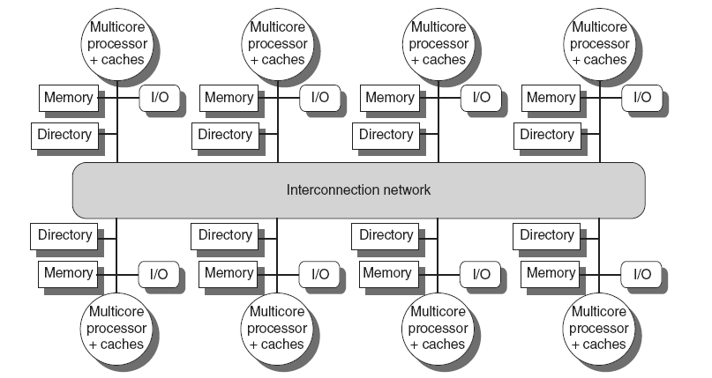
Multicore Based systems
Implementing in shared L3 cache
Keep bit vector of size = # cores for each block in L3
Not scalable beyond shared L3
IBM Power 7
AMD Opteron 8430
Distributed Shared Memory and Directory-Based Coherence
Copyright © 2012, Elsevier Inc. All rights reserved.
Notes:
The University of Adelaide, School of Computer Science
令和2年4月9日
Chapter 2 — Instructions: Language of the Computer
33
Cache coherent NUMA is a standard style for the server architecture. Also in this case, nodes are UMA processors. Each node has its home memory and directory mechanism which keep the cache coherence. This mechanism is a bit complicated compared with the snoop cache, but I will explain it in this class.

Slide 34
Xeon Phi Microarchitecture
All cores are connected through the ring
interconnect.
All L2 caches are coherent with directory
based management.
Core
Core
Core
Core
L2
Cache
L2
Cache
L2
Cache
L2
Cache
GDDR MC
GDDR MC
TD
TD
TD
TD
GDDR MC
GDDR MC
TD
TD
TD
TD
Core
Core
Core
Core
L2
Cache
L2
Cache
L2
Cache
L2
Cache
So, Xeon Phi is classified into
CC (Cache Coherent) NUMA.
Of course, all cores are multithreaded, and provide 512 SIMD instructions.
Notes:
Intel’s accelerator Xeon Phi also uses this CC-NUMA architecture. All cores are connected through ring interconnect.

Slide 35
COMA machine DDM(Data Diffusion Machine）
Ｄ
．．．
．．．
．．．
．．．
Notes:
COMA is really interesting architecture. But since it is rarely used recently, I will skip this structure.

Slide 36
NORA/NORMA
No shared memory
Communication is done with message passing
Simple structure but high peak performance
Cost effective solution.
Hard for programming
Cluster Computing
Suitable for data-centers
Tile Processors: On-chip NORMA for embedded applications
Notes:
OK. let me explain the last style of MIMD, NORA or NORMA. This machine has no shared memory. Thus, communication must be done with message passing. This machine can be built just by connecting PCs with the network, and by connecting a lot of PCs, the high peak performance can be obtained. That is, it is a cost-effective solution. However, for executing a single job in parallel, we need to use message passing libraly like MPI. I will introduce it in this class. This architecture is sometimes called computer clusters. They are used in data centers, since they are mostly used for request level parallelism.

Slide 37
PC Cluster
Beowulf Cluster (NASA’s Beowulf Projects 1994, by Sterling)
Commodity components
TCP/IP
Free software
Others
Commodity components
High performance networks like Infiniband
Dedicated software
Notes:
Beowulf Cluster by NASA’s Beowulf project is an origin of PC cluster. They tried to build a powerful cluster by PC with commodity components, standard network using TCP/IP, and free software. However, some recent PC clusters use a dedicated interconnection network like Infiniband and dedicated sotware.

Slide 38
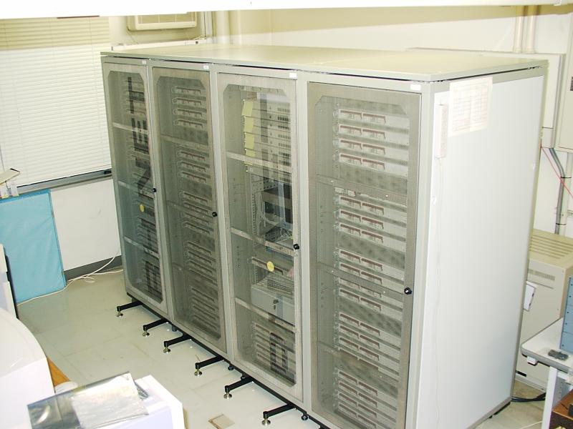
RHiNET-2 cluster
Notes:
This photo is a cluster built by us in a national project.

Slide 39
All techniques are combined
Nodes with CPU (Multi-core) are connected with NORA/NORMA
Clusters in data-centers.
Nodes with CPUs(Multi-core)+GPUs(SIMD/many-core) are connected with NORA/NORMA
Tsubame (TIT) and other supercomputers
Nodes with Multi-core are connected with NUMA
K-supercomputer
Notes:
I explained various type of classification, but note that all techniques are combined recently. They are examples.

Slide 40
Heterogeneous vs. Homogeneous
Homogeneous: consists of the same processing elements
A single task can be easily executed in parallel.
Unique programming environment
Heterogeneous: consisting of various types of processing elements
Accelerators or Domain Specific Architectures (DSAs) are used.
High performance per cost
Most recent high-end processors for cellular phone use this structure
However, programming is difficult.
Notes:
When a system is built with the same processing elements, it is called a heterogeneous system. It has a benefits like them.
Heterogenous system uses accelerators or domain specific architectures for a specific job. Recently, heterogenous systems are increasing in supercomputing or data centers.

Slide 41
Multi-core + Accelerator
I / O
System Agent
GPU 1
Core 1
GPU 2
Core 2
Core4
LLC
GPU
Video Decoder
memory
controller
Core3
LLC
Platform
Interface
Core2
LLC
Core1
LLC
Intel’s Sandy Bridge
AMD’s Fusion APU
Notes:
Recently, some multi-core systems embed GPU and multi-core in the same chip.
41

Slide 42
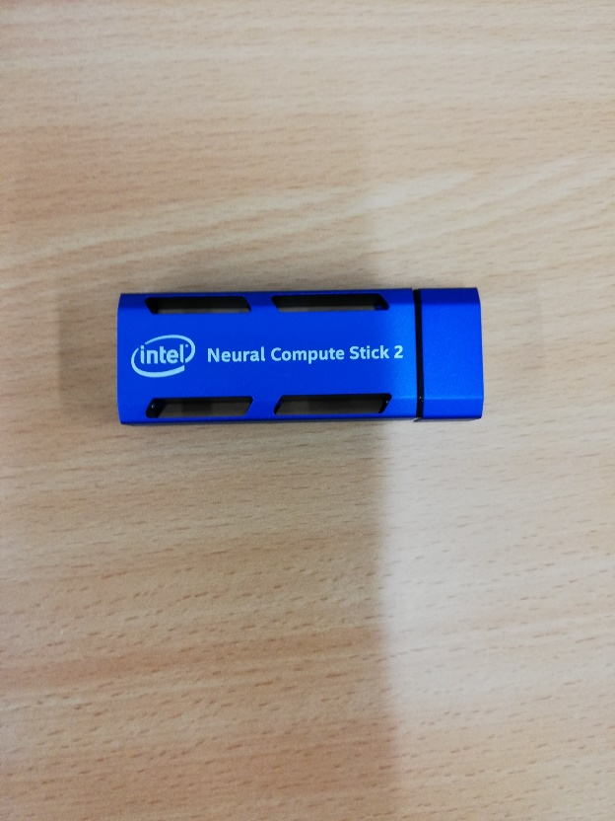
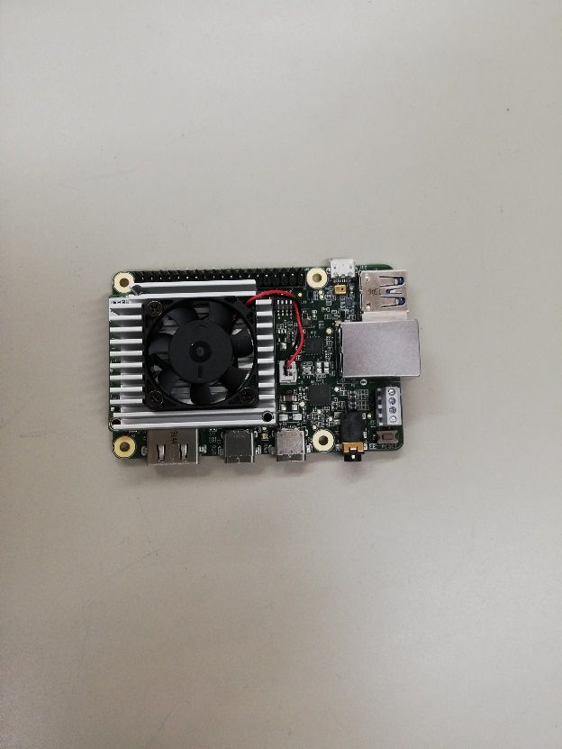
Domain Specific Architectures (DSAs)
Intel’s Neural Compute Stick 2
Google’s edge TPU
(Tensor Processing Unit)
Parallel Architectures for Specific Application (AI/DNN) are used.
Notes:
The domain specific architectures are active especially in the field of deep learning of the AI application. For example, in the edge TPU by Google uses a systolic algorithm, a type of parallel hardware algorithm.

Slide 43
Classification
Ｆｉｎｅ ｇｒａｉｎ
ＳＩＭＤ
Ｃｏａｒｓｅ ｇｒａｉｎ
Multiprocessors
Stored
programming
based
Bus connected UMA
Switch connected UMA
Ｓｉｍｐｌｅ ＮＵＭＡ
ＣＣ－ＮＵＭＡ
ＣＯＭＡ
ＭＩＭＤ
ＮＵＭＡ
ＮＯＲＡ
Multicomputers
Systolic architecture
Data flow architecture
Mixed control
Demand driven architecture
Others
Notes:
This map is the classification of parallel architectures introduced in this class.

Slide 44
glossary 3
Flynn’s Classification: Flynn(Stanford大の教授）が論文中に用いた分類、内容は本文を参照のこと
Coarse grain：粗粒度、この場合はプロセッシングエレメントが浮動小数演算が可能な程度大きいこと。反対がFine grain（細粒度）で、数ビットの演算しかできないもの
Illiac-IV, BSP, GF-11, Connection Machine CM-2，MP-2などはマシン名。SIMDの往年の名機
Synchronization:同期、Shared Memory:共有メモリ、この辺は後の授業で詳細を解説する
Message passing:メッセージ交換。共有メモリを使わずにデータを直接交換する方法
Embedded System:組み込みシステム
Homogeneous:等質な Heterogeneous：性質の異なったものから成る
Coherent Cache:内容の一貫性が保障されたキャッシュ、Cache Consistencyは内容の一貫性、これも後の授業で解説する
Commodity Component: 標準部品、価格が安く入手が容易
Power 5, Origin2000, Cray XD-1,AP1000,NCUBE などもマシン名。The earth simulatorは地球シミュレータ,IBM BlueGene/Lは現在のところ最速

Slide 45
Terms(1)
Multiprocessors：
MIMD machines with shared memory
（Strict definition：ｂｙ Ｅｎｓｌｏｗ Ｊｒ．）
Shared memory
Shared I/O
Distributed OS
Homogeneous
Extended definition: All parallel machines（Wrong usage）
Multicomputer
ＭＩＭＤ machines without shared memory, that is ＮＯＲＡ／ＮＯＲＭＡ
Notes:
Finally, I will introduce some terms in this area. Some are old fashioned and not used recently.

Slide 46
Term(2)
Multicore
On-chip multiprocessor.
Mostly UMA.
Symmetric Multi-Processor SMP
Historically, SMP is used for multi-chip multiprocessor
Manycore
On-chip multiprocessor with a lot of cores
GPUs are also referred as “Manycore”.
Notes:
Multicore and manycore are not technical words, but recently, they are popularly used.

Slide 47
Exercise 1
AIST(The National Institute of Advanced Industrial Science and Technology) developed a supercomputer for AI application called ABCI.
It won the 8th place of the TOP-500 supercomputer ranking (2019.11).
How do you classify ABCI ?
Check the website and describe your opinion.
If you take this class, send the answer with your name and student number to hunga4125@gmail.com
You can use either Japanese or English.
The deadline is 2 weeks later.

