Slide 1
Indirect(centralized) switching networks
Computer Architecture
AMANO, Hideharu
Textbook pp.９２～１３0

Slide 2
Indirect (Centralized) interconnection networks
Symmetric:
MIN (Multistage Interconnection Networks)
Each node is connected with equal latency and bandwidth
Asymmetric:
Fat-tree, base-m n-cube, etc.
Locality of communication can be used.
Notes:
Indirect networks are classified into two classes. Symmetric and asymmetric. First symmetric network is explained.

Slide 3
MIN（Multistage Interconnection Network)
Multistage connected switching elements form a large switch.
Symmetric
Smaller number of cross-points, high degree of expandability
Bandwidth is smaller and
latency is larger than those of crossbar
Notes:
MIN is multistage connected switching elements which form a large switch. It is basically symmetric, and smaller number of cross-points, and high degree of expandability. Of course, the bandwidth is smaller and latency is larger than those of crossbar.

Slide 4
Properties of MIN
Throughput for random communication
Permutation capability
Partition capability
Fault tolerance
Simple Routing
Notes:
There are several properties required for MIN.

Slide 5
Classification of MIN
Blocking network：Conflict may occur for destination is different：Ｎlog₂Ｎ type standard MIN,π-network,
Re-arrangeable：Conflict free scheduling is possible：Benes network、Clos network（rearrangeable configuration）
Non-blocking：Conflict free without scheduling：Clos network (non-blocking configuration)、Batcher-Banyan network
Notes:
MIN is classified into three categories. In the blocking network, conflict may occur for destination is different. Nlog2N type standard MIN is popularly used. Re-arrangeable network is conflict free if it is well scheduled. Non-blocking network is conflict free without scheduling.

Slide 6
Blocking Networks
Standard Nlog₂N networks
Omega network
Generalized Cube
Baseline
Pass through ratio (throughput) is the same.
Π-network
Notes:
Representative blocking networks are standard Nlog2N networks. Omega network, Generalized Cube and Baseline networks are representative ones. There are some interesting blocking network like pi-network.

Slide 7
Omega network
000
000
001
001
010
010
011
011
100
100
101
101
110
110
111
111
The number of switching element （２ｘ２, in this case） is １／２・Nｘlog₂N
Notes:
Standard NlogN network uses ½ N by log2N switches if 2x2 switches are used. This slide has 8 inputs, 4 by 3 switches are used. Omega network uses perfect shuffle for all connections between stages.

Slide 8
Perfect Shuffle
Rotate to left
０００
００１
０１０
０１１
１００
１０１
１１０
１１１
０００
０１０
１００
１１０
００１
０１１
１０１
１１１
Inverse Shuffle
Rotate to right
Notes:
Perfect shuffle is a permutation which generated by rotating label to the left direction. Inverse shuffle is obtained by rotating to right. Omega network uses this interconnection.

Slide 9
Destination Routing
1→３
Check the destination tag from MSB
If 0 use upper link, else use lower link.
５→６
000
000
001
001
０
010
010
１
011
011
１
100
100
101
１
101
110
０
110
１
111
111
Notes:
Destination routing can be applied in Omega network. Let’s check the destination tag from MSB. If the label is 0, use the upper link, else use lower link. It is easy to find the route.

Slide 10
Blocking Property
０→０
４→２
000
X
000
001
001
010
010
011
011
100
100
101
101
110
110
111
111
For different destination, multiple paths conflict
Notes:
In blocking network, even for different destination, multiple paths conflict with each other.

Slide 11
For using large switching elements（Delta network）
Shuffle connection is also used.
００
０
１
２
３
００
０１
０１
１０
２
１０
１１
１１
２０
０
１
２
３
１
２０
２１
２１
３０
３０
３１
３１
In the current art of technology, 8x8 (4x4) crossbars are advantageous.
Notes:
2x2 switching elements sometimes inconvenient. Of course, we can use larger switching elements. The label is 4-ary number but the destination routing can be used in the same manner.

Slide 12
Omega network
The same connection is used for all stages.
Destination routing
A lot of useful permutations are available.
Problems on partitioning and expandability.
Notes:
Let’s make a summary of Omega network.

Slide 13
Generalized Cube (Butterfly)
000
000
000
000
000
100
001
001
010
001
010
010
011
011
100
100
100
100
101
101
110
101
110
110
111
111
Links labeled with 1bit distance are connected
to the same switching element.
Notes:
Generalized cube is another type of standard Nlog2N network. Unlike Omega network, the interconnection between stages is different. Set all element to the straight and links labeled with 1bit distance are connected to the same switching element. The connection is somehow similar to the hypercube.

Slide 14
Routing in Generalized Cube
000
000
001
001
010
010
0
011
011
1
0
100
100
101
101
110
110
111
111
The source label and destination label is compared (Ex-Or）：
Same(0)：Straight Different (1)：Exchange
001→011
010
Notes:
Routing in Generalized Cube is also similar to that of hypercube. Let’s compare the source label and destination label, If 0, use straight, otherwise use exchange. The label is changed into the destination label, resulting to find the path.

Slide 15
Partitioning
000
000
001
001
010
010
011
011
100
100
101
101
110
110
111
111
The communication in the upper half never
disturbs the lower half.
Notes:
Generalized cube can be partitioned naturally. That is, when the first stage is set in the straight manner, the network is divided into two pieces, each of which is separated. The communication in the upper half never disturb the lower half.

Slide 16
Expandability
A size of network can be used as an element of larger size networks
Notes:
Generalized cube is expandable. That is, by adding the extra stage, a larger size generalized cube can be formed with two generalized cubes.

Slide 17
Generalized Cube
Destination routing cannot be applied.
The routing tag is generated by exclusive or of source label and destination label.
Partitioning
Expandability
Notes:
Let’s make a summary of the Generalized Cube.

Slide 18
Baseline Network
3bit shuffle
2bit shuffle
000
000
001
001
001
001
010
010
010
011
011
100
100
100
101
101
110
110
111
111
The area of shuffling is changed.
Notes:
The last Nlog2N network introduced here is Baseline Network. It also uses perfect shuffle interconnection, but unlike Omega network the area of shuffling is changed for the stage. That is, for the connection between 1st stage and 2nd stage, shuffle is applied to all 3 bits. But, for the next connection, only 2 bits are shuffled like this.

Slide 19
Destination Routing in Baseline network
000
000
001
1
001
010
010
011
011
100
1
100
101
101
0
110
110
111
111
Just like Omega network
Notes:
In Baseline network, the destination routing can be applied just like Omega network.

Slide 20
Partitioning in Baseline
000
000
001
001
010
010
011
011
100
100
101
101
110
110
111
111
Notes:
Partitioning property and expandability are used like Generalized Cube.

Slide 21
Baseline network
Providing both benefits of Omega and Generalized Cube
Destination Routing
Partitioning
Expandability
Used in NEC’s Cenju
Notes:
Baseline network has both benefits of Omega and Generalized Cube. It was used NEC’s supercomputer Cenju.

Slide 22
Quiz
Assume that 2x2 crossbar Is used for a switching element of 32inputs Omega network. For making the calculation simple, only 1bit is used for each input. Calculate the number of cross-points used in the network, and compare with 32inputs crossbar switch.
Notes:
Here is a quiz. Let’s compare the number of crosspoints of 32 inputs Omega network and the crossbar.

Slide 23
Π network
000
000
001
001
010
010
011
011
100
100
101
101
110
110
111
111
Tandem connection of two Omega networks
Notes:
Pi network consists of tandem connection of two Omega networks. By connecting multiple networks, we can improve the permutation capability.

Slide 24
Bit reversal permutation (Used in FFT)
000
000
０
１
２
３
０
４
２
６
１
５
３
７
001
001
010
010
011
011
100
100
４
５
６
７
101
101
110
110
111
111
Conflicts occur in Omega network.
Notes:
Permutation is changing the order of numbers. Perfect shuffle is one of the famous permutation. There are various type of permutation. For example bit reversal permutation is used in FFT. It can be done by reading the label from the least significant bit. However, this permutation causes conflicts in Omega network.

Slide 25
Bit reversal permutation in Π network
000
０
５
２
７
１
４
３
６
000
０
４
２
６
１
５
３
７
001
001
010
010
011
011
100
100
101
101
110
110
111
111
The first Omega：Upper input has priority.
The next Omega：Destination Routing
Conflict free
Notes:
By connecting two Omega networks, the permutation becomes conflict free. In the first Omega network, the upper input has the priority, then, the destination routing can be applied.

Slide 26
Permutation capacity
All possible permutation is conflict free ＝ Rearrangeable networks
Three tandem connection of Omega network is rearrangeable.
The tandem connection of Omega and Inverse Omega (Baseline and Inverse Baseline) is rearrangeable. Benes network
Notes:
If all possible permutation is conflict free, it means that it is a rearrangeable network. By connecting three Omega networks tandemly, it becomes rearrangeable. Also, the tandem connection of Omega and Inverse Omega or Baseline and Inverse Baseline is rearrangeable. It is called Benes network.

Slide 27
Ｂｅｎｅｓ Network
000
000
001
001
010
010
011
011
100
100
101
101
110
110
111
111
Note that the center of stage is shared.
The rearrangeable network with the smallest hardware requirement.
Notes:
This diagram shows a rearrangeable network called Benes network. Note that the center of the stage is shared, so this network is the rearrangeable network with the smallest number of stages. Of course, the scheduling is needed to pass a permutation without conflict.

Slide 28
Non-blocking network
Ｃｌｏｓ network
ｍ＞ｎ１＋ｎ２－１: Non-blocking
ｍ＞＝ｎ２: Rearrangeable
Else: Blocking
Notes:
Clos network is famous as a non-blocking network, but it can be non-blocking, rearrangeable and blocking based on the size of switching elements and number of their inputs and outputs.

Slide 29
Clos network
ｎ１ｘｍ
ｒ１ｘｒ２
ｍｘｎ２
3-stage
...
...
ｒ２
ｒ１
ｍ
m=n1+n2-1： Non-blocking
m=n2：Rearrangeable
m<n2：Blocking
The number of intermediate
stage dominates the permutation
capability.
Notes:
Clos network consists of three stage, distributer, exchanger and concentrator. the distributer is formed with n1xm switch, the exchanger, r1xr2, and the concentrator mxn2 switches, respectively. If m=n1+n2-1, it becomes non-blocking network, because there are a lot of switches in the exchanger and all dedicated paths can be reserved. If m=m2, it becomes the rearrangeable, and m<n2, it becomes the clocking network.
Non-blocking style Clos network is sometimes used for high performance large scale switch instead of the crossbar.

Slide 30
Batcher network
５
７
０
４
２
１
３
６
５
７
４
０
１
２
６
３
０
４
５
７
６
３
２
１
０
１
２
３
４
５
６
７
Bitonic sorting network
Notes:
Batcher network is actually a sorting network. The label of each packet is compared and sorted. It uses a bitonic sorting method which makes a bitonic number whose order is increasing once and then decreasing.

Slide 31
Batcher-Banyan
Omega
Baseline
５
７
０
４
２
１
３
６
５
７
４
０
１
２
６
３
０
４
５
７
６
３
２
１
０
１
２
３
４
５
６
７
Sorted input is conflict free in the banyan network
Notes:
Batcher banyan network is formed by connecting bitonic sorter in front of the N log N blocking network. For the sorted data, all of N log N blocking networks introduced here are conflict free..

Slide 32
Banyan networks
Only a path is provided between source and destination.
The number of intermediate stages is flexible.
Approach from graph theory
SW-Banyan，CC-Banyan，Barrel Shifter
Irregular structure is allowed.
Notes:
Batcher Banyan network uses the name banyan. The name comes from a tree in tropical region, and used mostly in the field of graph theory. In Banyan networks, only a path is provided between source and destination. The number of intermediate stages is flexible, and various types of the network are included. SW-banyan, CC-banyan and even Barrel shifter belong in this class.

Slide 33
Batcher-banyan
If there are multiple packets to the same destination, the conflict free condition is broken
→ The other packets may conflict.
The extension of banyan network is required.
The number of stages is large.
→ Large pass through time
The structure of sorting network is simple.
Notes:
There are two major problems in Batcher-banyan network. If there are multiple labels, conflict may happen. So, we need to the duplicated label at the connection point of the sorter and the N log N network. Another is its large number of stages. Although the structure of sorting network is simple, large pass through time is needed.

Slide 34
Classification of MINs
Clos
Batcher
Banyan
Ｎｏｎｂｌｏｃｋｉｎｇ
Banyan
Omega
Benes
Baseline
π
Ｒｅａｒｒａｇｅｂｌｅ
Generalized Cube
Ｂｌｏｃｋｉｎｇ
Notes:
This diagram shows the classification of MINs.

Slide 35
Fault tolerant MINs
Multiple paths
Redundant structure is required.
On-the-fly fault recovery is difficult.
Improving chip yield.
Notes:
N log N standard MINs are not fault tolerant, since they have only a path from a source to a destination. In order to be fault tolerant, redundant structure is required. Although on-the-fly fault recovery is difficult, it contributes to improve the chip yield.

Slide 36
Extra Stage Cube (ESC)
000
000
001
001
010
010
011
Ｘ
011
100
100
101
101
110
110
111
111
An extra stage＋Bypass mechanism
If there is a fault on stages or links, another path is used.
Notes:
Extra Stage Cube provides an extra stage and small bypassing mechanism. If a link is faulty, the redundant stage is activated and the alternative path is used.

Slide 37
The buffer in switching element
000
000
001
001
010
010
011
011
100
100
101
101
110
110
111
111
Conflicting packets are stored into buffers.
Notes:
The switching element often provides the packet buffer, since even in non-blocking network the conflict may happen if the destination label of two packets are the same. In this case, conflicting packets are stored into the buffer.

Slide 38
Hot spot contention
000
001
Hot spot
010
011
100
101
110
111
Buffer is saturated in the figure of tｒｅｅ
(Ｔｒｅｅ Ｓａｔｕｒａｔｉｏｎ）
Notes:
This structure works well when traffic is not concentrated. When a number of packets are forwarded to the same destination, it is called a hot spot. In this case, the packet buffers are saturated in the form of tree whose root is the hot spot

Slide 39
Relaxing the hot spot contention
Wormhole routing with Virtual channels → Direct network
Message Combining
Multiple packets are combining to a packet inside a switching element (IBM RP3)
Implementation is difficult (Implemented in SNAIL)
Notes:
It is called a tree saturation. In order to solve it, we should introduce the virtual circuits introduced later in this lesson or combining several packets.

Slide 40
Other issues in MINs
MIN with cache control mechanism
Directory on MIN
Cache Controller on MIN
MINs with U-turn path → Fat tree
Notes:
MINs have been well researched. For example, combining cache directory or cache itself on the switching elements have been investigated. Providing U-turn path is another interesting idea. It forms a type of fat-tree.

Slide 41
Glossary 1
Rearrange-able: スケジュールすることにより、出力が重ならなければ内部で衝突しないようにできる構成
Perfect shuffle:シャッフルは、トランプの札を切る時に使う単語だが、ここでは、配線のつなぎ方の方式のひとつ。Inverse shuffleは逆シャッフルと呼ばれ、逆接続方式。
Destination routing：目的地のラベルだけで経路を決める方法
Permutation:並び替え、順列のことだが、ここでは目的地ラベルが重ならない経路を無衝突で生成することができる能力のこと
Partitioning:ネットワークを分離して独立に使える能力のこと
Fault tolerance:耐故障性。一部が故障しても全体がダウンしないような性質、Fault tolerant MINは複数経路を持たせたMIN
Expandability:拡張性、小さなものからサイズを大きくしていくことのできる性質
Hot spot contention: 局所的に交信が集中して、これが全体に波及すること。
Tree saturation: Hot spot contentionによりネットワークが木の形で飽和していく現象。特にMINで起きる。Message Combiningは、メッセージをくっつけてまとめることによりこれを防止する方法の一つ
Notes:
This is the glossary of the 1st segment.

Slide 42
Centralized interconnection networks
Symmetric:
MIN (Multistage Interconnection Networks)
Each node is connected with equal latency and bandwidth
Asymmetric:
Fat-tree, base-m n-cube, etc.
Locality of communication can be used.
Notes:
Next, let me explain asymmetric network. They have been used because of its high bandwidth and the property which can use the locality of communication.

Slide 43
Asymmetric indirect networks
Intermediate position between direct interconnection network and MINs
High communication capability considering cost
base-m n-cube（Hyper crossbar）
SR2000、CP-PACS
Fat Tree
CM-5，Some WS Clusters
Hyper-cross
ADENART
Notes:
Asymmetric indirect networks are at intermediate position between direct interconnection network and MINs. It can achieve high communication capability considering their cost. So, they have been used in real machines.

Slide 44
base-m n-cube (Hyper crossbar)
crossbar
router
PU
Used in Toshiba’s Prodigy and Hitachi’s SR8000
Notes:
Base-m n-cube uses crossbar instead of direct links of k-ary n-cube. This diagram shows the 2 dimensional one, but it can be extended like k-ary n-cubes. It was used in Toshiba’s Prodigy and Hitachi’s SR8000. Also, similar concept is used in the network of FPGAs.

Slide 45
HyperCross
(pi,pj)→ (pj,*),(*,pi)
0,0
0,3
Xbar
Xbar
Xbar
3,0
3,3
Used in ADENART by Matsushita
Notes:
Hyper Cross network is interesting network to use the crossbars. A node labeled with pi,pj is connected with pj.* and *,pi with crossbars. It was used in Matsushita’s supercomputer.

Slide 46
Fat Tree
Fat tree is defined with (p,q,r) where p: num. of upper links, q: num. of lower links
r: num, of hierarchy, This example is FT(2,4,2)
Notes:
Fat tree is different from a tree of the direct network in two points. First, the intermediate nodes are switching elements, and computational nodes are only allocated in the leaves. Second, it is consisted of duplicated tree structure. Fat tree is defined with p,q,r where p is the number of upper links, q is the number of lower links and r is the number of the hierarchy. This example shows 2,4,2.

Slide 47
Return paths with MIN = Fat tree
Notes:
When we provide return paths in MINs, it becomes a fat tree. It is Generalized cube but by providing the U-turn paths, it becomes fat tree (2,2,4)

Slide 48
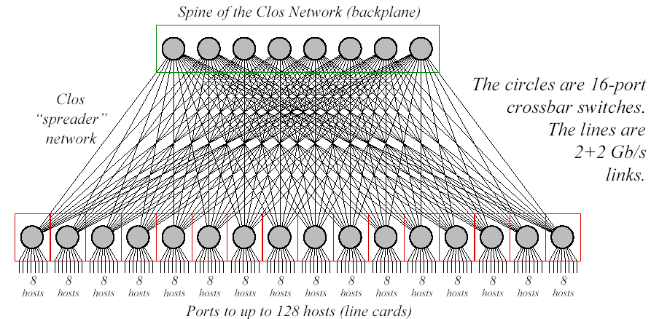
Myrinet-Clos（１/2)
１２８nodes(Clos128)
Notes:
Myrinet-Clos or some network called Clos is not actually Clos network but hypercube. Clos means the way to connect switches that there is a link for every switch in the different stage.

Slide 49
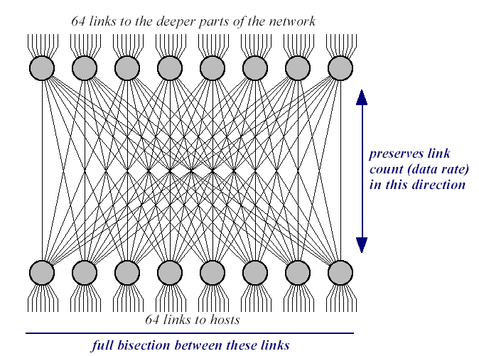
Clos64+64
Notes:
This structure shows a variation of the fat tree.

Slide 50
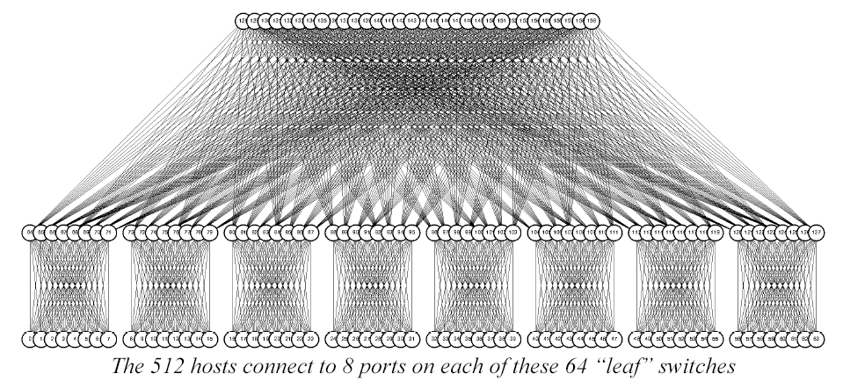
Myrinet-Clos(2/2)
512nodes
Notes:
It can connect a lot of nodes. Most of clusters use this kind of high-p and q fat trees. This is because a switching fabric with a large number of inputs / outputs can be easily used recently. They are sometimes called a high-radix network.

Slide 51
Flattened butterfly
router (2×2)
router
(5×5)
2-ary 4-fly
2⁴=16 node
2-ary 4-flat
2⁴=16 node
A row of MIN is fused. High radix → High bandwidth
Multiple paths can be formed
Notes:
Flattened butterfly is formed by fusing multiple switching elements of generalized cube network. This example shows to connect 32 nodes.
51

Slide 52
Dragonfly
…
…
…
global channels
Intra-group int. network
R0
R1
．．．
Rn-1
Inter-group int. network
…
…
…
terminal channels
…
G0
G1
Gg
…
…
…
P0
P1
Pk-1
Pk
Pk+1
P2k-1
PN-k-1
PN-k
PN-1
Notes:
Dragonfly is based on the similar concept of hierarchical networks of direct networks. A part of links to form a intra-group interconnection network can be used to form an inter-group network. Usually, the inter-group interconnection network is complete interconnection.

Slide 53
G1
G2
G8
……
An example of Dragonfly
(N=72)
G0
R0
R1
R2
R3
The interconnection of
this part can be Flatten Butterfly
P0
P1
P2
P3
P4
P5
P6
P7
Notes:
In this example, interconnection of the internal group is also complete interconnection. Two links from a switch are used to form complete interconnection between other groups.

Slide 54
4x24 Full mesh Connected Cycles (FCC)
24 Cycles are
connected
in full-mesh
6x4
6x4
…
…
2..7
2..7
1
0
x4
0
1
……
x4
x4
x4
1
0
0
1
2..7
2..7
…
…
6x4
6x4
96 boards are connected
Notes:
This is another example of Dragonfly. In this case, a simple ring is used to form an inner-group network.

Slide 55
Summary: k-ary n-cube vs. high radix
Sorry. This figure is not based on accurate data.
supercomputers
k-ary
n-cube
high radix
clusters/data centers
high radix
k-ary n-cube
NoCs
Now, they dominate the world of Interconnection Networks
Notes:
I am sorry but this graph is not based on accurate data. In supercomputers, high radix networks like fat tree or dragonfly and direct interconnection of k-ary n-cubes are popularly used. In computer cluster or data centers, high radix network is major, although for NoCs, k-ary n-cube are popularly used. This is also today’s summary

Slide 56
Exercise
Every path between source and destination is determined with the destination routing in Omega network. Prove (or explain) the above theory in Omega network with 8-input/output.
Notes:
This is today’s exercise. Use the labels s2 s1 s0 for the source and d2 d1 d0 for the destination, and how the source label is changed to the destination label.

