Slide 1
Computer Architecture Guidance
Keio University
AMANO, Hideharu
hunga@am．ics．keio．ac．jp

Slide 2
Contents
Techniques on Parallel Processing
Parallel Architectures
Parallel Programming → On real machines
Advanced uni-processor architecture
→ Special Course of Microprocessors
(by Prof. Yamasaki, Fall term)

Slide 3
Class
Lecture using Powerpoint
The ppt file is uploaded on the web site http://www.am.ics.keio.ac.jp, and you can down load/print before the lecture.
Please check it on every Friday morning.
Homework: mail to: hunga@am.ics.keio.ac.jp

Slide 4
Evaluation
Exercise on Parallel Programming using GPU (50%)
Caution! If the program does not run, the unit cannot be given even if you finish all other exercises.
This year a new GPU P100 is now under preparation.
Homework: after every lecture (50%)

Slide 5
glossary 1
英語の単語がさっぱりわからんとのことなので用語集を付けることにする。
このglossaryは、コンピュータ分野に限り有効である。英語一般の使い方とかなり異なる場合がある。
Parallel: 並列の 本当に同時に動かすことを意味する。並列に動いているように見えることを含める場合をconcurrent(並行）と呼び区別する。概念的にはconcurrent > parallelである。
Exercise: ここでは授業の最後にやる簡単な演習を指す
GPU: Graphic ProcessingUnit Cell Broadband Engineを使って来たが、2012年からGPUを導入した。今年は新型でより高速のを使う予定

Slide 6
Computer Architecture 1 Introduction to Parallel Architectures
Keio University
AMANO, Hideharu
hunga@am．ics．keio．ac．jp

Slide 7
Parallel Architecture
A parallel architecture consists of multiple processing units
which work simultaneously.
→ Thread level parallelism
Purposes
Classifications
Terms
Trends

Slide 8
Boundary between Parallel machines and Uniprocessors
Uniprocessors
ILP(Instruction Level Parallelism)
A single Program Counter
Parallelism Inside/Between instructions
TLP(Thread Level Parallelism)
Multiple Program Counters
Parallelism between processes and jobs
Parallel Machines
Definition
Hennessy & Petterson’s
Computer Architecture: A quantitative approach

Slide 9
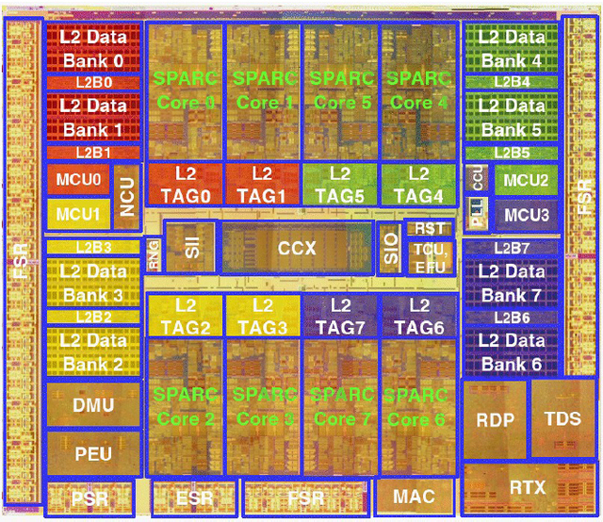
Multicore Revolution
The end of increasing clock frequency
Consuming power becomes too much.
A large wiring delay in recent processes.
The gap between CPU performance and memory latency
The limitation of ILP
Since 2003, almost every computer
became multi-core.
Even smartphones use 2-core/4-core
CPU.
Niagara 2

Slide 10
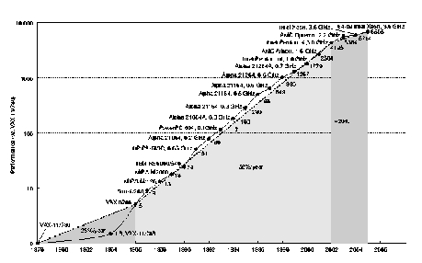
End of Moore’s Law in computer performance
No way to increase performance other than
Increasing the number of cores
1.2/year
1.5/year=Moore’s Law
1.25/year

Slide 11
Purposes of providing multiple processors
Performance
A job can be executed quickly with multiple processors
Dependability
If a processing unit is damaged, total system can be available： Redundant systems
Resource sharing
Multiple jobs share memory and/or I/O modules for cost effective processing：Distributed systems
Low energy
High performance even with low frequency operation
Parallel Architecture: Performance Centric!

Slide 12
Low Power by using multiple processors
n X performance with n processors,
but the power consumption is also n times.
If so, multiple processors does not contribute at all.
P_{dynamic} ∝ Vdd² × f
f_{max} ∝ Vdd
If n processor achieves n times performance, f_{max} can be 1/n. → Vdd can be lowered. → P_{dynamic} can be lowered.

Slide 13
Quiz
Assume a processor which consumes 10W with 1.8V Vdd and 3GHz clock.
You can improve performance by 10x with 10 processors, it means that the same performance can be achieved with 300MHz clock.
In this case, Vdd can be 1.0V.
How much power does the machine with 10 processors consume?

Slide 14
glossary 2
Simultaneously: 同時に、という意味でin parallelとほとんど同じだが、ちょっとニュアンスが違う。in parallelだと同じようなことを同時にやる感じがするが、simultaneouslyだととにかく同時にやればよい感じがする。
Thread: プログラムの一連の流れのこと。Thread level parallelism（TLP)は、Thread間の並列性のことで、ここではHennessy and Pattersonのテキストに従ってPCが独立している場合に使うが違った意味に使う人も居る。これに対してPCが単一で命令間にある並列性をILPと呼ぶ
Dependability: 耐故障性、Reliability(信頼性）, Availability(可用性）双方を含み、要するに故障に強いこと。Redundant systemは冗長システムのことで、多めに資源を持つことで耐故障性を上げることができる。
Distributed system:分散システム、分散して処理することにより効率的に処理をしたり耐故障性を上げたりする

Slide 15
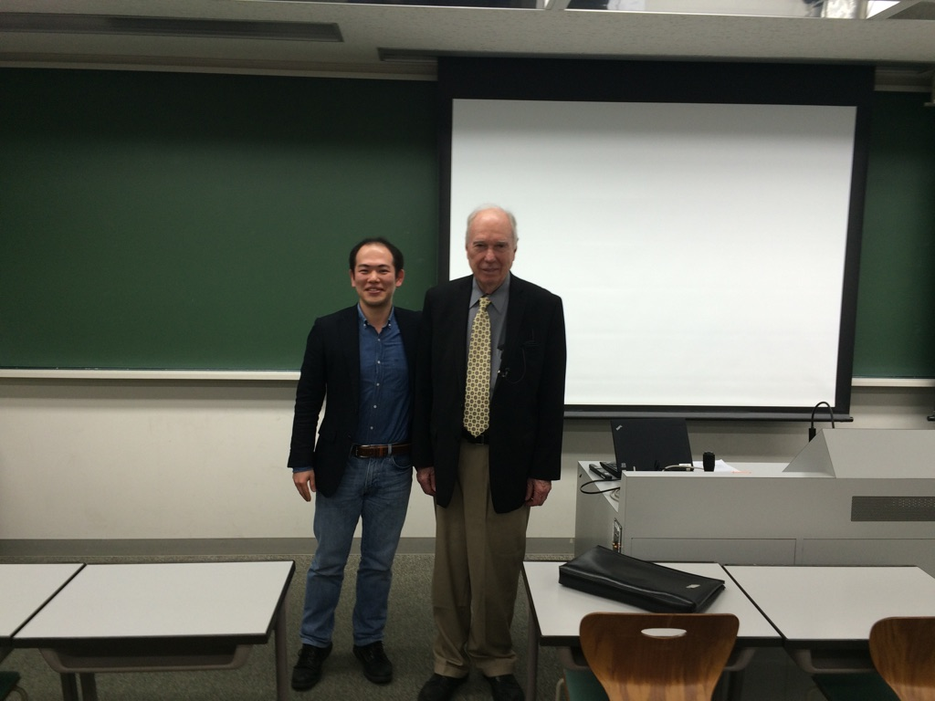
Flynn’s Classification
The number of Instruction Stream： M(Multiple)/S(Single)
The number of Data Stream：M/S
SISD
Uniprocessors（including Super scalar、VLIW）
MISD： Not existing（Analog Computer）
SIMD
MIMD
He gave a lecture at Keio
in the last year

Slide 16
SIMD (Single Instruction Stream Multiple Data Streams
All Processing Units executes the same instruction
Low degree of flexibility
Illiac-IV/MMX instructions/ClearSpeed/IMAP/GP-GPU（coarse grain）
CM-2,（fine grain）
Instruction
Memory
Instruction
Processing Unit
Data memory

Slide 17
Two types of ＳＩＭＤ
Coarse grain：Each node performs floating point numerical operations
Old SuperComputers: ILLIAC-IV，BSP,GF-11
Multimedia instructions in recent high-end CPUs
Accelerator: GPU, ClearSpeed
Dedicated on-chip approach: NEC’s IMAP
Fine grain：Each node only performs a few bits
operations
ICL DAP, CM-2，MP-2
Image/Signal Processing
Connection Machines （CM-2) extends the application to Artificial Intelligence (CmLisp)

Slide 18
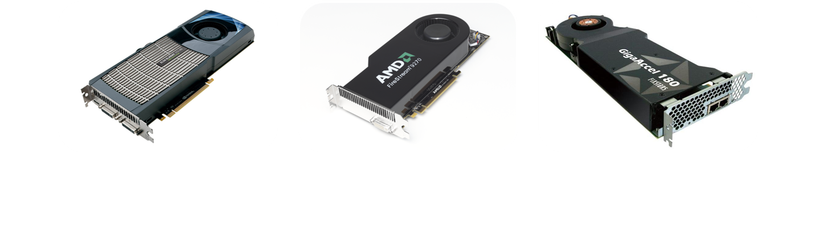
GPGPU(General-Purpose computing on Graphic ProcessingUnit)
Titan (NVIDIA K20X, 3rd place of Top500)
TSUBAME2.5(NVIDIA K20X )
A lot of supercomputers in Top500 use GPU.
※()内は開発環境
Notes:
18
近年、CPUとGPUやCELLといったマルチコアアクセラレータを組み合わせて使うハイブリッドの計算環境が普及しています。
例えばTOP500を見ると、TSUBAMEのNVIDIA GPUはもちろんですが、↑こういったATIのGPUを使ったスパコンも存在します。
またCell B.E.を搭載したアクセラレータもあります。
これらのアクセラレータを使って高い性能が得られるのですが、アクセラレータごとに異なる環境を用いなければなりませんでした。
そこで、Open CLという開発環境が登場しました。
OpenCLは、マルチコアプロセッサ向けの共通プログラミング環境で、Open CLにより、
異なるアーキテクチャでもCライクの同一ソースコードで開発が可能になりました。

Slide 19
GPU is not just a simple SIMD.
A mixture of SIMD/MIMD/Multithread
GeForce
GTX280
240 cores
Host
Input Assembler
Thread Execution Manager
Thread Processors
Thread Processors
Thread Processors
Thread Processors
Thread Processors
…
PBSM
PBSM
PBSM
PBSM
PBSM
PBSM
PBSM
PBSM
PBSM
PBSM
Load/Store
Global Memory

Slide 20
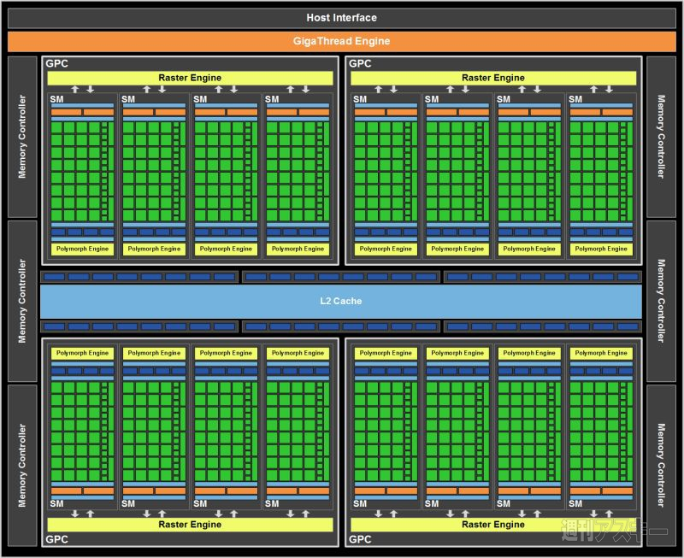
GPU(NVIDIA’s GTX580)
128 Cores
128 Cores
L2 Cache
128 Cores
128 Cores
512 GPU cores ( 128 X 4 )
768 KB L2 cache
40nm CMOS 550 mm^2

Slide 21
The future of SIMD
Coarse grain SIMD
GPGPU became a main stream of accelerators.
Other SIMD accelerators are hard to be survive.
Multi-media instructions will have been used in the future.
Fine grain SIMD
Advantageous to specific applications like image processing
On-chip accelerator

Slide 22
MIMD
Each processor executes individual instructions
Synchronization is required
High degree of flexibility
Various structures are possible
Processors
Interconnection
networks
Memory modules (Instructions・Data）

Slide 23
Classification of MIMD machines Structure of shared memory
UMA(Uniform Memory Access Model）
provides shared memory which can be accessed from all processors with the same manner.
NUMA(Non-Uniform Memory Access Model）
provides shared memory but not uniformly accessed.
NORA/NORMA（No Remote Memory Access Model）
provides no shared memory. Communication is done with message passing.

Slide 24
UMA
The simplest structure of shared memory machine
The extension of uniprocessors
OS which is an extension for single processor can be used.
Programming is easy.
System size is limited.
Bus connected
Switch connected
A total system can be implemented on a single chip
On-chip multiprocessor
Chip multiprocessor
Single chip multiprocessor→ Multicore
IBM Power series
NEC/ARM chip multiprocessor for embedded systems

Slide 25
An example of UMA：Bus connected
Note that it is a logical image
Main Memory
shared bus
Snoop
Cache
Snoop
Cache
Snoop
Cache
Snoop
Cache
PU
PU
PU
PU
SMP (Symmetric MultiProcessor),
On chip multiprocessor or multicore

Slide 26
MPCore (ARM+NEC)
Private
FIQ Lines
SMP for Embedded
application
…
Interrupt Distributor
Timer
CPU
interface
Timer
CPU
interface
Timer
CPU
interface
Timer
CPU
interface
Wdog
Wdog
Wdog
Wdog
IRQ
IRQ
IRQ
IRQ
CPU/VFP
CPU/VFP
CPU/VFP
CPU/VFP
L1 Memory
L1 Memory
L1 Memory
L1 Memory
Snoop Control Unit (SCU)
Coherence
Control Bus
Private
Peripheral
Bus
Duplicated
L1 Tag
Private
AXI R/W
64bit Bus
L2 Cache
Notes:
４つのコアを搭載可能、共有データのキャッシングはスヌープで管理する

Slide 27
SUN T1
Core
L2
Cache
bank
Core
Directory
Crossbar
Switch
Core
L2
Cache
bank
Memory
Core
Directory
Core
L2
Cache
bank
Core
Directory
Core
FPU
L2
Cache
bank
Core
Single issue six-stage pipeline
RISC with 16KB Instruction cache/
8KB Data cache for L1
Directory
Total 3MB, 64byte Interleaved

Slide 28
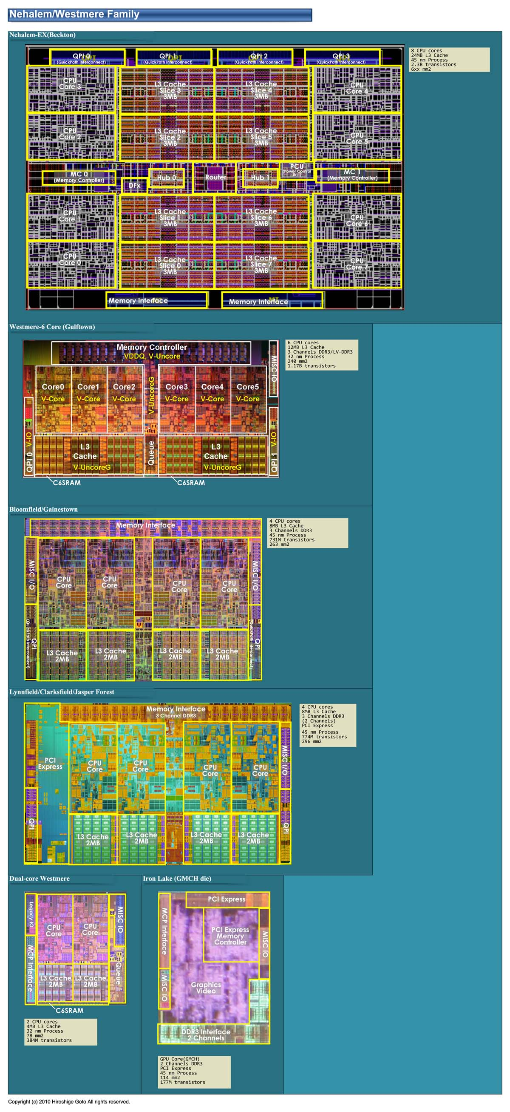
Multi-Core (Intel’s Nehalem-EX)
CPU
L3 Cache
CPU
CPU
CPU
CPU
L3 Cache
CPU
CPU
CPU
8 CPU cores
24MB L3 cache
45nm CMOS 600 mm^2

Slide 29
Heterogeneous vs. Homogeneous
Homogeneous: consisting of the same processing elements
A single task can be easily executed in parallel.
Unique programming environment
Heterogeneous: consisting of various types of processing elements
Mainly for task-level parallel processing
High performance per cost
Most recent high-end processors for cellular phone use this structure
However, programming is difficult.

Slide 30
NEC MP211
Heterogeneous type UMA
Camera
LCD
Cam
DTV
I/F.
Sec.
Acc.
DMAC
USB
OTG
3D
Acc.
Rot-
ater.
Image
Acc.
LCD
I/F
ARM926
PE0
Ｍｕｌｔｉ－Ｌａｙｅｒ ＡＨＢ
Bus Interface
APB
Bridge1
SRAM
Interface
TIM1
ARM926
PE1
TIM2
Scheduler
APB
Bridge0
Inst.
RAM
On-chip
SRAM
(640KB)
TIM3
SDRAM
Controller
ARM926
PE2
PMU
WDT
Async
Bridge0
Mem. card
PLL
OSC
PCM
SMU
uWIRE
SPX-K602
DSP
Async
Bridge1
IIC
UART
INTC
TIM0
GPIO
SIO
FLASH
DDR SDRAM

Slide 31
NUMA
Each processor provides a local memory, and accesses other processors’ memory through the network.
Address translation and cache control often make the hardware structure complicated.
Scalable：
Programs for UMA can run without modification.
The performance is improved as the system size.
Competitive to WS/PC clusters with Software DSM

Slide 32
Typical structure of NUMA
Node ０
０
Node １
１
Ｉｎｔｅｒｃｏｎｎｅｃｔｏｎ
Ｎｅｔｗｏｒｋ
２
Node 2
３
Node ３
Logical address space

Slide 33
Classification of NUMA
Simple NUMA：
Remote memory is not cached.
Simple structure but access cost of remote memory is large.
CC-NUMA：Cache Coherent
Cache consistency is maintained with hardware.
The structure tends to be complicated.
COMA:Cache Only Memory Architecture
No home memory
Complicated control mechanism

Slide 34
Supercomputer 「K」
Memory
L2 C
Core
Core
Tofu Interconnect
6-D Torus/Mesh
Core
Core
Inter
Connect
Controller
Core
Core
Core
Core
SPARC64 VIIIfx Chip
RDMA mechanism
NUMA or UMA+NORMA
4 nodes/board
96nodes/Lack
24boards/Lack

Slide 35
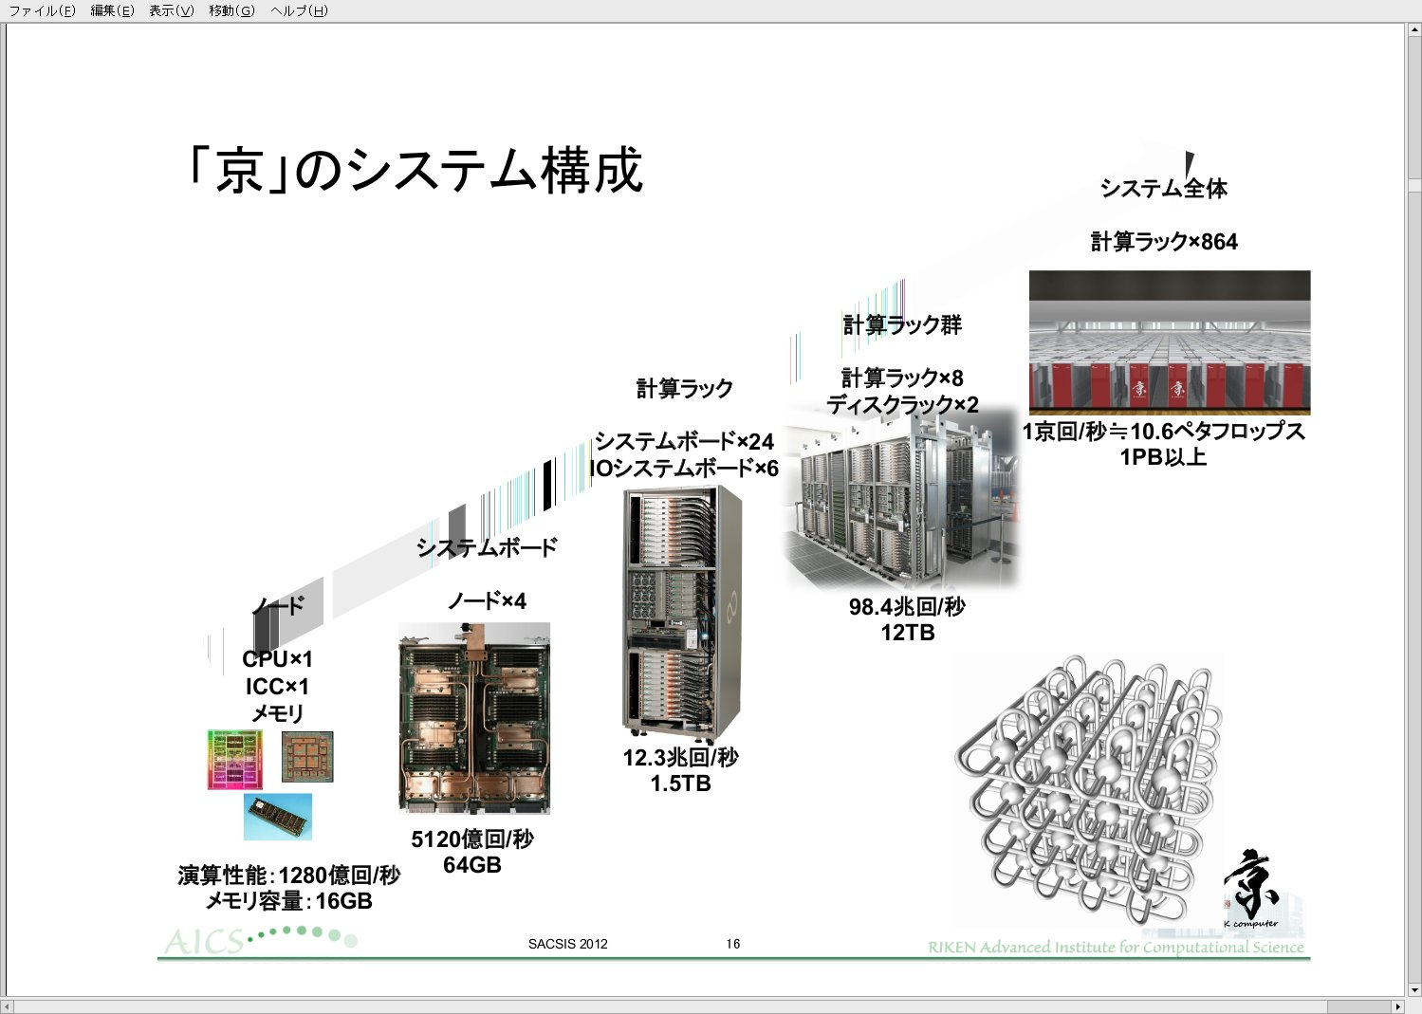
SACSIS2012 Invited speech

Slide 36
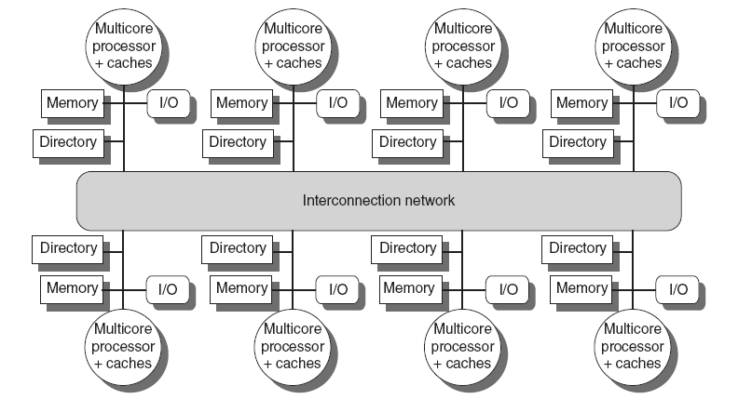
Multicore Based systems
Implementing in shared L3 cache
Keep bit vector of size = # cores for each block in L3
Not scalable beyond shared L3
IBM Power 7
AMD Opteron 8430
Distributed Shared Memory and Directory-Based Coherence
Copyright © 2012, Elsevier Inc. All rights reserved.
Notes:
The University of Adelaide, School of Computer Science
平成30年4月6日
Chapter 2 — Instructions: Language of the Computer
36

Slide 37
Xeon Phi Microarchitecture
All cores are connected through the ring
interconnect.
All L2 caches are coherent with directory
based management.
Core
Core
Core
Core
L2
Cache
L2
Cache
L2
Cache
L2
Cache
GDDR MC
GDDR MC
TD
TD
TD
TD
GDDR MC
GDDR MC
TD
TD
TD
TD
Core
Core
Core
Core
L2
Cache
L2
Cache
L2
Cache
L2
Cache
So, Xeon Phi is classified into
CC (Cache Coherent) NUMA.
Of course, all cores are multithreaded, and provide 512 SIMD instructions.

Slide 38
DDM(Data Diffusion Machine）
Ｄ
．．．
．．．
．．．
．．．

Slide 39
NORA/NORMA
No shared memory
Communication is done with message passing
Simple structure but high peak performance
Cost effective solution.
Hard for programming
Inter-PU communications
Cluster computing
Tile Processors: On-chip NORMA for embedded applications

Slide 40
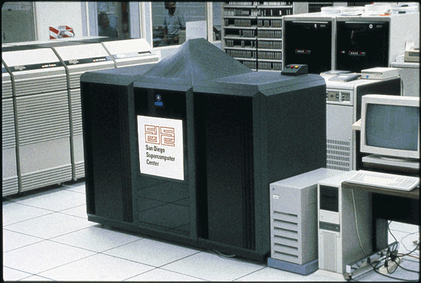
Early Hypercube machine nCUBE2

Slide 41
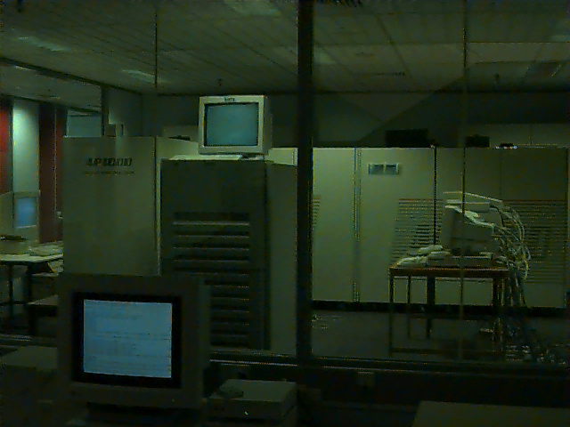
Fujitsu’s NORA AP1000(1990)
Mesh connection
SPARC

Slide 42
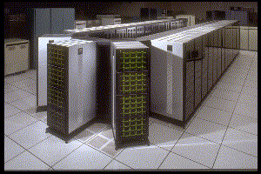
Intel’s Paragon XP/S(1991)
Mesh connection
i860

Slide 43
PC Cluster
Beowulf Cluster (NASA’s Beowulf Projects 1994, by Sterling)
Commodity components
TCP/IP
Free software
Others
Commodity components
High performance networks like Myrinet / Infiniband
Dedicated software

Slide 44
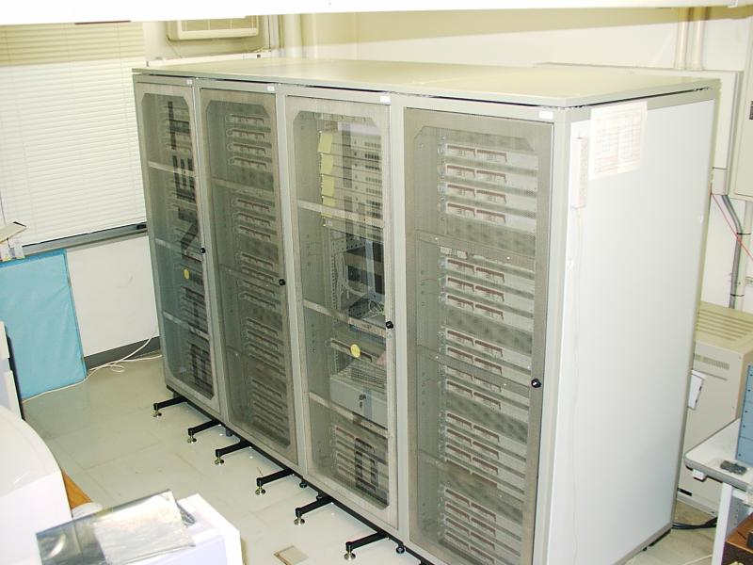
RHiNET-2 cluster

Slide 45
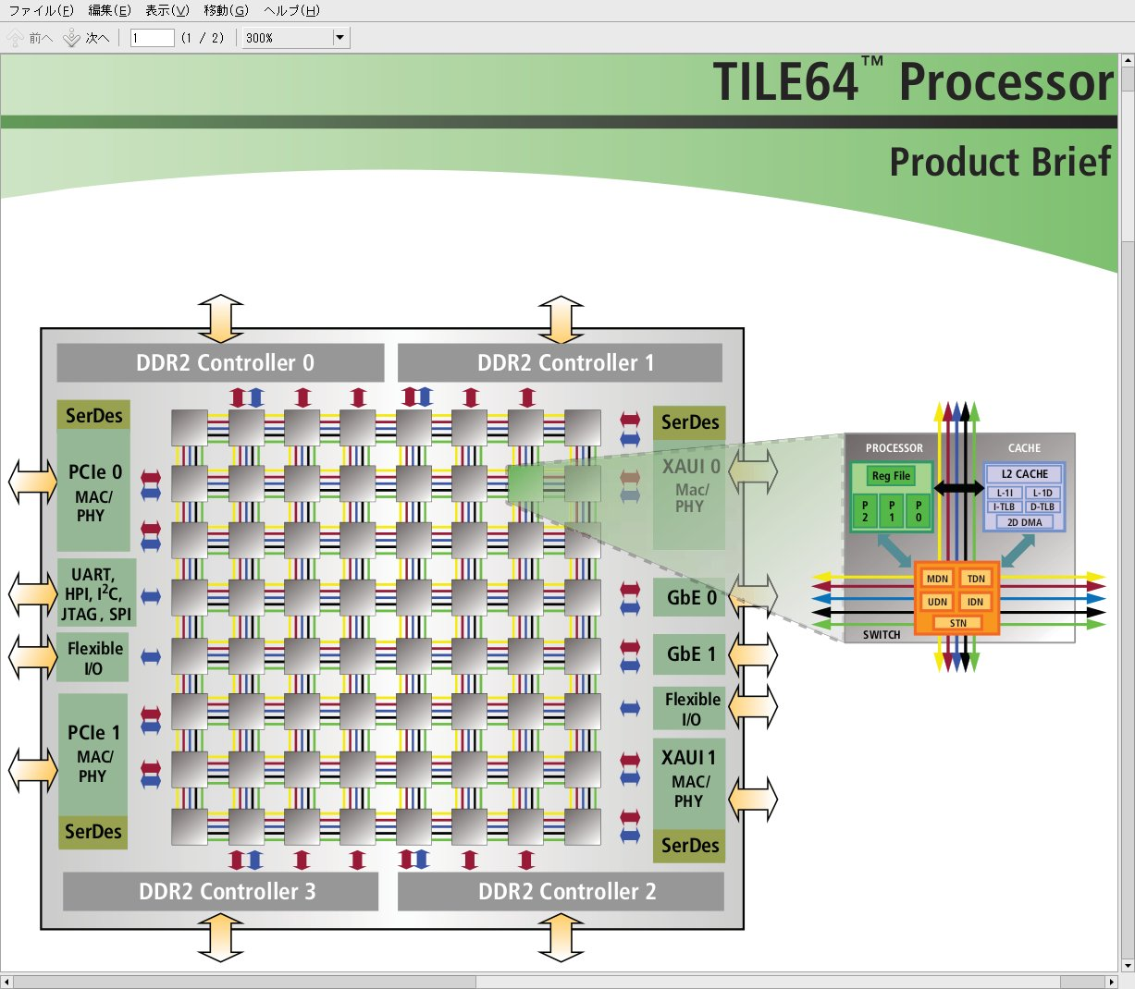
Tilera’s Tile64
Tile Pro, Tile Gx
Linux runs in
each core.

Slide 46
All techniques are combined
Nodes with CPU (Multi-core) are connected with NORA/NORMA
Clusters in data-centers.
Nodes with CPUs(Multi-core)+GPUs(SIMD/many-core) are connected with NORA/NORMA
Tsubame (TIT) and other supercomputers
Nodes with Multi-core are connected with NUMA
K-supercomputer

Slide 47
Multi-core + Accelerator
I / O
System Agent
GPU 1
Core 1
GPU 2
Core 2
Core4
LLC
GPU
Video Decoder
memory
controller
Core3
LLC
Platform
Interface
Core2
LLC
Core1
LLC
Intel’s Sandy Bridge
AMD’s Fusion APU
Notes:
47

Slide 48
glossary 3
Flynn’s Classification: Flynn(Stanford大の教授）が論文中に用いた分類、内容は本文を参照のこと
Coarse grain：粗粒度、この場合はプロセッシングエレメントが浮動小数演算が可能な程度大きいこと。反対がFine grain（細粒度）で、数ビットの演算しかできないもの
Illiac-IV, BSP, GF-11, Connection Machine CM-2，MP-2などはマシン名。SIMDの往年の名機
Synchronization:同期、Shared Memory:共有メモリ、この辺は後の授業で詳細を解説する
Message passing:メッセージ交換。共有メモリを使わずにデータを直接交換する方法
Embedded System:組み込みシステム
Homogeneous:等質な Heterogeneous：性質の異なったものから成る
Coherent Cache:内容の一貫性が保障されたキャッシュ、Cache Consistencyは内容の一貫性、これも後の授業で解説する
Commodity Component: 標準部品、価格が安く入手が容易
Power 5, Origin2000, Cray XD-1,AP1000,NCUBE などもマシン名。The earth simulatorは地球シミュレータ,IBM BlueGene/Lは現在のところ最速

Slide 49
Terms(1)
Multiprocessors：
MIMD machines with shared memory
（Strict definition：ｂｙ Ｅｎｓｌｏｗ Ｊｒ．）
Shared memory
Shared I/O
Distributed OS
Homogeneous
Extended definition: All parallel machines（Wrong usage）
Multicomputer
ＭＩＭＤ machines without shared memory, that is ＮＯＲＡ／ＮＯＲＭＡ

Slide 50
Term(2)
Multicore
On-chip multiprocessor.
Mostly UMA.
Symmetric Multi-Processor SMP
Historically, SMP is used for multi-chip multiprocessor
Manycore
On-chip multiprocessor with a lot of cores
GPUs are also referred as “Manycore”.

Slide 51
Classification
Ｆｉｎｅ ｇｒａｉｎ
ＳＩＭＤ
Ｃｏａｒｓｅ ｇｒａｉｎ
Multiprocessors
Stored
programming
based
Bus connected UMA
Switch connected UMA
Ｓｉｍｐｌｅ ＮＵＭＡ
ＣＣ－ＮＵＭＡ
ＣＯＭＡ
ＭＩＭＤ
ＮＵＭＡ
ＮＯＲＡ
Multicomputers
Systolic architecture
Data flow architecture
Mixed control
Demand driven architecture
Others

Slide 52
Exercise 1
Pezy’s supercomputer Gyoukou got the 4th place at TOP500 in 2017 November.
But, the president of Pezy was arrested for crime of fraud later.
It uses Pezy SC2 as an accelerator.
Which type is Pezy SC2 classified into ?
If you take this class, send the answer with your name and student number to hunga@am.ics.keio.ac.jp
You can use either Japanese or English.

