Slide 1

Direct (Ｄｉｓｔｒｉｂｕｔｅｄ ) Interconnection Networks
AMANO, Hideharu
Textbook pp.１４０－１４７

Slide 2
Direct（Distributed Interconnection ）Networks
Nodes are connected with links directly.
Locality of communication can be used.
Extension to large size is easy.
Notes:
Direct interconnection networks are sometimes called distributed networks. Nodes are connected with links directly, and so the locality of communication can be used. So, extension to large size is generally easy.

Slide 3
Basic direct networks
Linear
Ring
Central concentration
Tree
Complete connection
Mesh
Notes:
Here are basic direct networks.

Slide 4
Metrics of Direct interconnection network（D and ｄ）
Diameter：D
  Number of hops between most distant two nodes through the minimal path
  ASPL(Average Shortest Path Length)
degree: d
  The largest number of links per a node.
D represents performance and ｄ represents cost
  Recent trends:
    Performance: Throughput
    Cost: The number of long links
Notes:
There are two famous metrics to characterize direct networks. Large D or diameter is the number of hops between distant two nodes through the minimal path. Average Shortest Path Length or ASPL is recently used instead of Diameter. Small d or degree is the largest number of links per a node. D represents performance and small d represents cost. But actually, performance is rather throughput and the cost is influenced by the number of long links.

Slide 5
Diameter
２（ｎ－１）
Notes:
For example, in this case, diameter is 4+4=8. Of course, we must count the minimal path. In general, the Diameter of the 2 D mesh is 2(n-1) where n is number of nodes in a dimension.

Slide 6
Other requirements
Uniformity：Every node/link has the same configuration.
Expandability: The size can be easily extended.
Fault Tolerance: A single fault on link or node does not cause a fatal damage on the total network.
Embeddability: Emulating other networks
Bisection Bandwidth
Notes:
There are other requirements for direct interconnection network. Let’s review the basic topology, and think whether they are established.

Slide 7
bi-section bandwidth
The total amount of data
traffic between two halves of
the network.
Notes:
Bi-section bandwidth is a minimum total amount of data traffic between two halves of the network. It must be measured at the bottlenecking point of the network.

Slide 8
Hypercube
0000
0001
0010
0011
0100
0101
0110
0111
1000
1001
1010
1011
1100
1101
1110
1111
Notes:
OK. Let me explain a famous direct interconnection network called hypercube. First we assign binary number to each node. Here there are sixteen nodes so we assign 4 digit binary. We connect two nodes whose bits are the same except the least significant bit. Here red links are defined. Then, let’s check the second bit. Blue links are added. Repeat this process until the most significant bit.

Slide 9
Routing on hypercube
0101→1100
0000
0001
0010
0011
Different bits
0100
0101
0110
0111
1000
1001
1010
1011
1100
1101
1110
1111
Notes:
The process to find the route between a source node to a destination node is called routing. For hypercube, a simple method can be used. Let’s compare the source label and destination label and check the different bit. In this example, the bit0 and bit3. The path can be established by using the link corresponding to the bit0 and bit3. Here, when we send the packet on the red link then violet link, it arrives at the destination node.

Slide 10
The diameter of hypercube
0101→1010
0000
0001
0010
0011
All bits are different
→ the largest distance
0100
0101
0110
0111
1000
1001
1010
1011
1100
1101
1110
1111
Notes:
It is easy to find the diameter of the hypercube. The most distant two nodes are nodes whose labels are completely different for all digits. In this case, four hops are needed. Thus, the diameter is log2n where n is the node number.

Slide 11
Characteristics of hypercube
D=d=ｌｏｇ₂Ｎ
High throughput, Bisection Bandwidth
Embeddability for various networks
Satisfies all fundamental characteristics of direct networks（Expandability is questionable）
Most of the first generation of NORA machines were hypercubes（iPSC，NCUBE，FPS-T）
Notes:
Apparently, the degree of the hypercube is log2N, that is the same as the diameter. It satisfies major requirements for direct interconnection network. High bi-section bandwidth. Embeddability for various networks, uniform and fault tolerant. The expandability is questionable, because for increasing the size, we must add extra links to all nodes. From these reasons, most of the first generation of NORMA machines used hypercube.

Slide 12
Problems of hypercube
Large number of links
  Large number of distant links
  High bandwidth links are difficult for a high performance processors.
Small D does not contribute performance because of innovation of packet transfer.
Programming is difficult: → Hypercube’s dilemma
Notes:
Hypercube has the following problems. First is a large number of links. Especially, the long links for distantly located nodes are required. It means that if we want to increase the bandwidth of each link, the cost becomes high. Small D is advantages of the hypercube, but its contribution to the performance becomes small by the recent innovation of packet transfer. Also, the programming is difficult. It is known as Hypercube’s dilemma.

Slide 13
Hypercube’s dilemma
Programming considering the topology is difficult unlike 2-D,3-D mesh/torus
Programming for random communication network cannot make the use of locality of communication.
2-D/3-D mesh/torus
  Killer applications fit to the topology
    Partial differential equation, Image processing,…
  Simple mapping strategy
    Frequently communicating processes should be
    assigned to neighboring nodes
Notes:
In hypercube, the programming considering the topology is difficult unlike 2-D or 3-D mesh/torus. However, if we make the program without considering any topology, it cannot make the use of locality of communication. On the centrally, 2-D/3-D mesh or torus has killer applications fit to the topology. For example, the partial differential equation and image processing can be naturally mapped to such topologies. Even for other applications, simple mapping strategy that frequently communication processes should be assigned to neighboring modes achieves good application mapping. This is the reason why hypercubes has not been popularly used since 1990’s.

Slide 14
ｋ-ａｒｙ ｎ-ｃｕｂｅ
Generalized mesh/torus
K-ary n digits number is assigned into each node
For each dimension (digit), links are provided to nodes whose labels are the same except the dimension in order.
Rap-around links (ｎ-1→０) form a torus, otherwise mesh.
“high-n” networks are used in recent supercomputers
  Tofu in K uses 6-torus
  Bluegene Q uses 5-torus
Notes:
k-ary n-cube is generalized mesh or torus. K-ary n digits number is assigned to each node. For each dimension corresponding to the digit of the node label, links are provided to nodes whose labels are the same except the dimension in order. If there are rap-around links, it is called a torus, otherwise, it is a mesh. Recent supercomputers use a high-n networks. For example, Tofu in K supercomputer uses 6-torus and IBM Blue-gene Q uses 5-torus.

Slide 15
k-ary n-cube
０
０
０
１
０
２
3-ary 1-cube
１
０
１
１
１
２
3-ary 2-cube
２
０
２
２
１
２
Notes:
Let me shown how 3-ary n-cube is formed. First we form 3-ary 1-cube by lineally connecting three nodes. Here, let’s provide three 3-ary 1-cubes and give the second digit. Then connect nodes whose first bit are the same in the order. We can get a 3-ary 2-cube.

Slide 16
k-ary n-cube
２
０
０
２
０
１
２
２
０
１
０
０
１
０
１
１
２
０
０
０
０
０
０
１
０
２
０
１
０
１
２
１
１
２
１
3-ary 1-cube
１
１
１
０
１
１
１
２
０
１
０
０
１
０
１
１
２
１
２
２
２
０
２
２
１
２
3-ary 2-cube
１
１
１
２
０
２
２
１
２
０
２
3-ａｒｙ 3-ｃｕｂｅ
０
０
２
０
２
１
２
Notes:
By providing three 3-ary 2-cubes, we can build 3-ary 3-cube with the same manner. That is give three 3-ary 2-cubes the third digit, and connect nodes with the same label except the digit. We can get 3-ary 3-cube.

Slide 17
３-ary 4-cube
0***
1***
2***
Notes:
We are living in the 3-D world. So, 4-dimentional torus is hard to imagine. But, it can be built the same manner. That is, let’s proved three 3-ary 3-cubes and give the forth digit. This diagram only shows the limited number of links.

Slide 18
３-ary 5-cube
0****
1****
degree: 2*n
Diameter: (k-1)*n
2****
Notes:
With the same manner, we can build 3-ary 5-cube, and any 3-ary n-cubes. Each node has two links for two neighboring nodes, so the degree is 2*n. We must send the packet k-1 hops to each dimension, thus, the diameter is (k-1)*n.

Slide 19
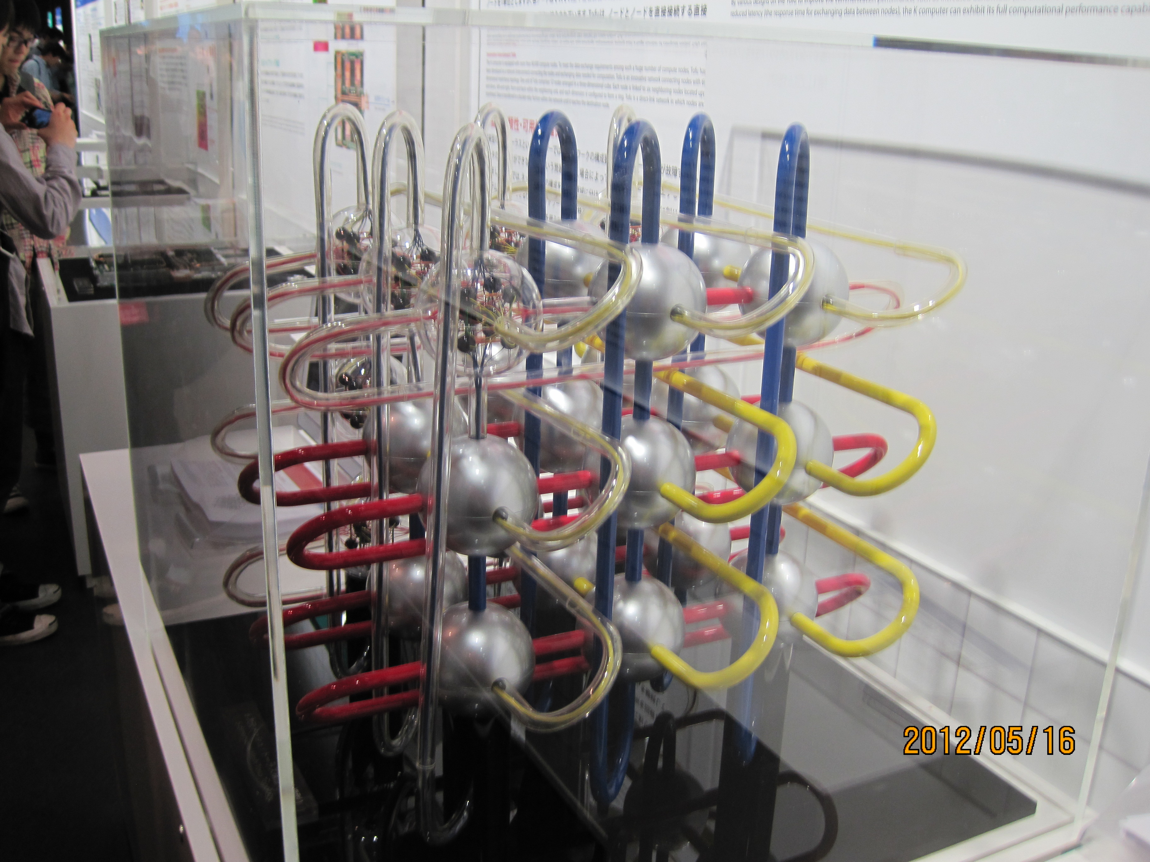
6-dimensional Torus
Tofu
Notes:
Supercomputer K uses 6-dimensional torus. It is a model of Tofu.

Slide 20
Properties of k-ary n-cube
A class of networks which has Linear, Ring 2-D/3-D mesh/torus and Hypercube（binary n-cube） as its member.
Small d=2n but large D（O(k ))
Large number of neighboring links
k-ary n-cube has been a main stream of NORA networks.
  binary n-cube → 2D/3D mesh/torus →5D/6D mesh/torus
1/n
Notes:
k-ary n-cube is a large family of networks including linear, ring 2-D/3-D mesh/torus and hypercube. The hypercube is binary n-cube. d is 2n and D is order k power (1/n). Since n tends to be small, d is small and D is large. In this case, a large ratio of neighboring links are for local nodes. k-ary n-cube has been a main stream of NORA networks.

Slide 21
Rise and fall of the members
n
hypercube machines
1980’s
16
HW router
Wormhole, VC
Bandwidth requirement
10
5D/6D Mesh/Torus
2010’s
5
Optical links,
Increasing size
Low-latency requirement
3
2
2D/3D Mesh/Torus 90’s-2000’s
2
100
1000
k
Notes:
In 1980’s hypercube machines were major trend. However, the performance of a single processor glowed rapidly. Also, introducing HW router, wormhole routing and virtual cut-through were introduced. The situation places the bandwidth on importance. So, 2D/3D mesh/torus with a wide bit-width is widely used. From 2010’s since optical links are introduced and the size of system further glowed, the number of dimensions was increased.

Slide 22
Quiz
Calculate Diameter (D) and degree (d) of the６-ａｒｙ 4-cube (mesh-type).
Notes:
Here is a quiz.

Slide 23
Glossary 1
Diameter:直径
degree:次数
Uniformity:均一性
Expandability:拡張性
Embeddability:埋め込み能力
Bisection bandwidth:2分割間転送量
Torus:両端が接続されたネットワークで、特にメッシュに対するものを指す。複数形はToriなので注意
ｎ-ary k-cube: n進ｋキューブ 2進キューブのことを特にハイパーキューブと呼ぶ
Notes:
The glossary of the first segment is here.

Slide 24
Advanced direct networks
Shuffle based networks
  De Bruijn, Kautz, Pradhan
Extended mesh/torus
  Midimew, RDT
Star Graph
Hierarchical networks
  CCC, Hypernet
Circular networks
  Circular Omega、MDCE
Network inside the chip (Network-on-Chip)
  Spidergon, Mesh of Tree, Fat-H Tree
  Some of them might be classified into indirect networks
Notes:
There are various types of direct networks. I will explain representative ones.

Slide 25
De Bruijn network
001
011
000
010
101
111
100
110
0
1
Notes:
De Bruijn network is a famous shuffle based network. As hypercube, binary numbers are assigned into each node. The label is shifted left, and 0 or 1 is inserted to the least significant bit. In this way, we got two node labels. Two links are provided from the node to these two nodes. Although this network is basically a uni-directional one, it can be used as a bi-directional network.

Slide 26
Routings for De Bruijn
001
011
000
010
101
111
100
110
0
Destination Routing
(001→101)
1
Notes:
On this network, destination routing can be applied. In this method, the label is checked from the MSB of the destination label. If it is 1, select the link for 1, otherwise select the link for 0. This guarantees that the packet arrives at least log-2-N steps. Unfortunately, this route is not a minimal one. In this case, this green path is shorter than the path from the destination routing.

Slide 27
B(k，n)
..
0
..
..
1
K-ary n-digits
..
k-1
Notes:
Like k-ary n-cubes, De Bruijn network can be generalized. Give the k-ary n-digits number to each node. Links are provided to k-1 nodes given by the shifting and inserting the numbers 0 to k-1.

Slide 28
Characteristics of De Bruijn
Benefits
  d=2k、D=n=logN
  When k=2, d=4、D=logＮ，that is, d of 2-dimensional mesh but D of hypercube.
Problems
  Optimal routing is difficult (not established yet).
  Destination routing cannot make a best use of communication locality.
  No killer applications.
  Self loop and duplicated links
Notes:
The degree of the De Bruijn network is 2k, that is there are k outgoing links and k incoming ones. Since the path was found the destination routing, D becomes log2N. If k=2, d becomes 4 and D becomes log2N. It means that it realizes d of 2-dimensional mesh with D for hypercube.
However there are problems shown here, and it is rarely used for real machines.

Slide 29
Kautz network
210
The same number
should not be at the
neighboring digit
121
101
012
212
010
120
201
102
021
202
020
Notes:
One of apparent problem of De Bruijn network is that there is some duplicated links. It can be solved by changing the assigned labels. In Lautz network, the same number should not be at the neighboring digit.

Slide 30
Circular networks
Circular Omega
  Advantageous for one-way communication
  Used in data-flow machine EM-4
MDCE(CCCB)
  Hierarchical structure of Circular Omega（Banyan）
  Used in massively parallel machine RWC-1
Notes:
Circular networks have been proposed for Japanese data-flow machines, since it is basically uni-directional network.

Slide 31
Circular Omega network
000
000
001
001
010
010
011
011
100
100
101
101
110
110
111
111
Notes:
Circular omega network borrows the concept of indirect interconnection networks which will be introduced in the next lesson. Unlike indirect networks, each squire includes a processing unit, and packets are circulated in the network.

Slide 32
Cube Connected Circular Banyan
Circular Banyan
3-Dimensional
Proposed for RWC-1
Notes:
Cube connected circular banyan is a 3-dimensional extension of the network. It was used in a Japanese national project.

Slide 33
Star graph
ABCD
DBCA
CBAD
CBDA
BACD
BDCA
BACD
CABD
CDBA
BCDA
ACBD
DCBA
CDAB
BDAC
DCAB
ADCB
DBAC
ADBC
ACDB
DACB
ABDC
DABC
CADB
BADC
Connection n! nodes
Notes:
Star graph is based on the completely different concept of other networks. Instead of numbers, symbols are assigned as labels. The links are provided to node whose label is formed by replacing the top label into others.

Slide 34
Routing on Star graph
ABCD
DBCA
CBAD
CBDA
BACD
BDCA
BACD
CABD
CDBA
BCDA
ACBD
DCBA
CDAB
BDAC
DCAB
ADCB
DBAC
ADBC
ACDB
DACB
ABDC
DABC
CADB
BADC
If Ａ is top, change with arbitrary symbol,
else, change with the symbol of destination
node
ＡＢＣＤ → ＤＡＢＣ
３（ｎ－１）／２
Notes:
Very simple, but minimal routing can be applied on this network. Assume that the starting label is ABCD. If the top symbol of the destination node is A, change with arbitrary symbol, else change with the symbol of destination node. It seems strange but look at this example. The diameter becomes 3(n-1)/2. The problem of this graph is that the node number must be factrial.

Slide 35
Hierarchical network
CCC(Cube Connected Cycles)
  ｈｙｐｅｒｃｕｂｅ＋loop
Hypernet
  Compete connection＋hypercube
Well combined, weak points of original networks are vanished.
Complicated routing, gap between hierarchies
Notes:
The next is hierarchical network. They are consisted of a combination of different networks.

Slide 36
CCC(Cube Connected Cycles)
000
001
100
101
0
1
2
010
011
110
111
Notes:
Cube connected cycles are combination of ring and hypercube. The problem of hypercube is a large number of links, a large degree. By replacing the node into cycle, the degree is fixed to only three. Each node has two links to form a ring and one for external ring.

Slide 37
Hyper Net
h
b
i
d
o
c
a
b
j
c
e
d
f
k
h
m
e
f
g
l
a
n
g
p
Other links are used for
further upper hierarchy
Notes:
Hyper Net consists of hyper cube and complete connection network. The links which are not used to form a hierarchy are used to form the upper hierarchy.

Slide 38
Extended mesh/torus
Including mesh/torus structure
Extended links for performance enhancement
  Reconfigurable Mesh
  Midimew
  RDT
Notes:
Mesh or Torus are so popularly used. there are directives to attaching extra links.

Slide 39
RDT(Recursive Diagonal Torus)
Notes:
The week point of the torus is diagonal directions. So, RDT forms upper hierarchy torus for the diagonal direction recursively. In this method, links are concentrated to specific nodes. So, usually, the upper hierarchy links are distributed with some rules.

Slide 40
Multicasting on the RDT
Notes:
RDT is used for distributing packets to neighboring nodes by using the turtle patterns shown here.

Slide 41
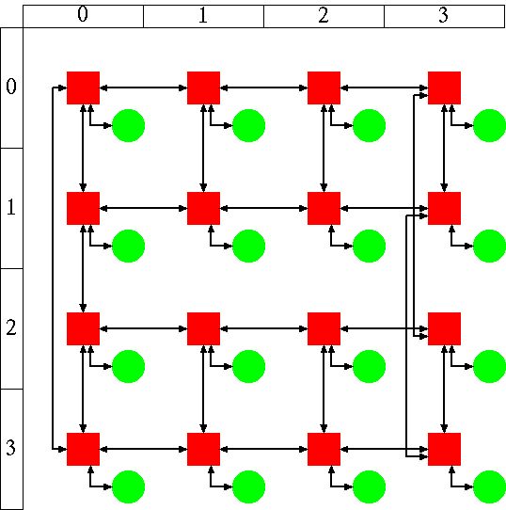
Topology for NoC: (1)
Spidergon
  Ring + diagonal links
  Node degree 3;
[Coppola, ISSOC’04]
[Bononi, DATE’06]
Spidergon (2-D layout)
router
core
Notes:
Interesting networks are formed considering the network on chip. Spidergon attaches diagonal links to the ring network. It can be layouted on the chip.

Slide 42
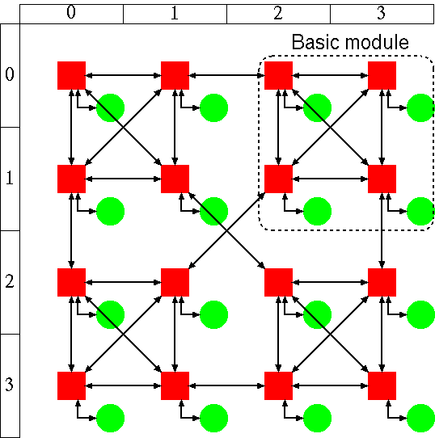
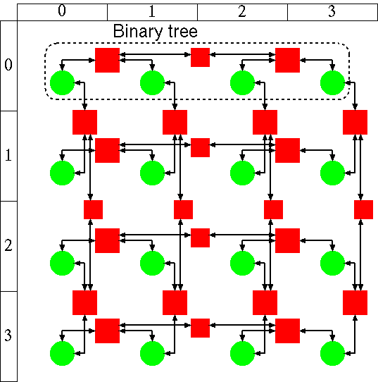
Topology for NoC: (2)
WK-recursive (d,k)
  hierarchical network
Mesh-of-Tree
  Mesh + Tree
WK-recursive (4,2)
Mesh-of-Tree
[Vecchia, FCGS’88]
router
計算コア
[Leighton, Math System theory’84]
[Rahmati, ICCD’06]
Notes:
WK-recursive and Mesh-of-Tree are also used for network on chips.

Slide 43
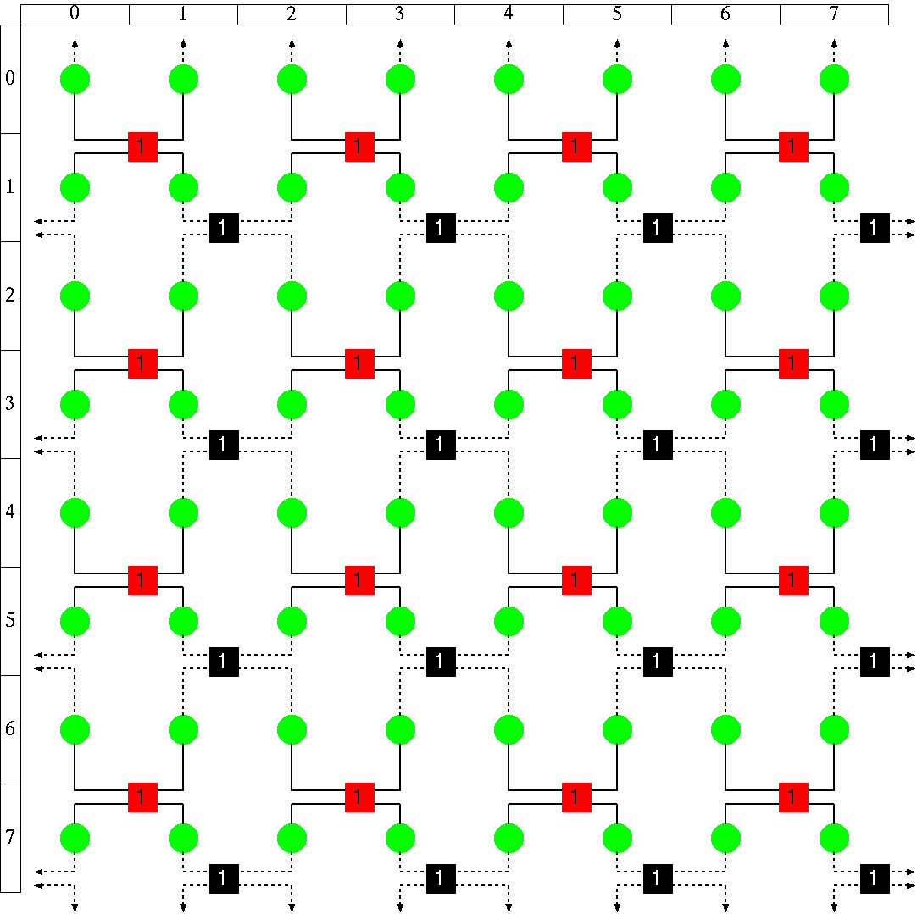
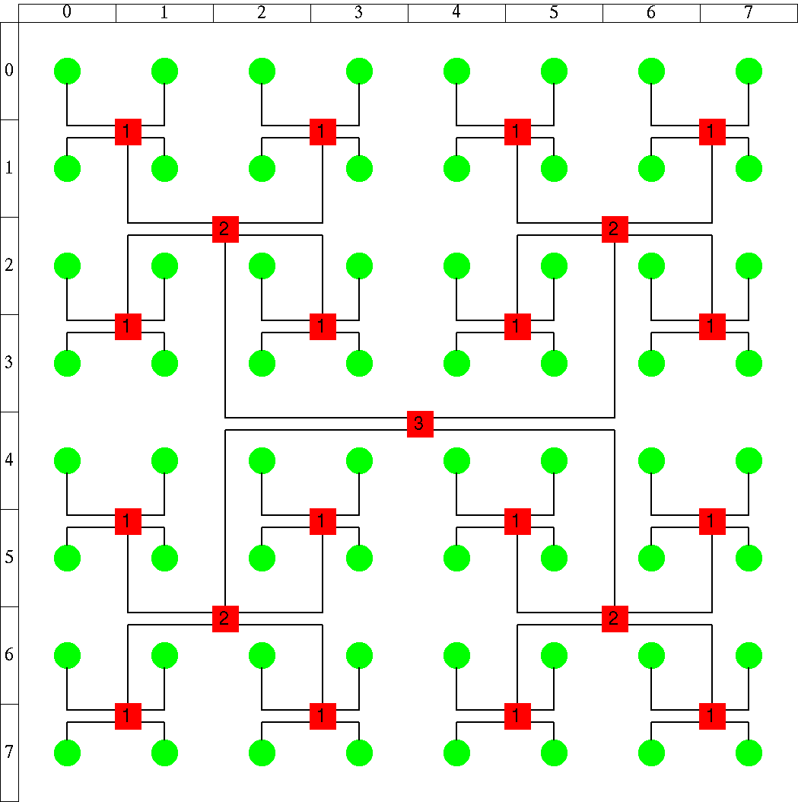
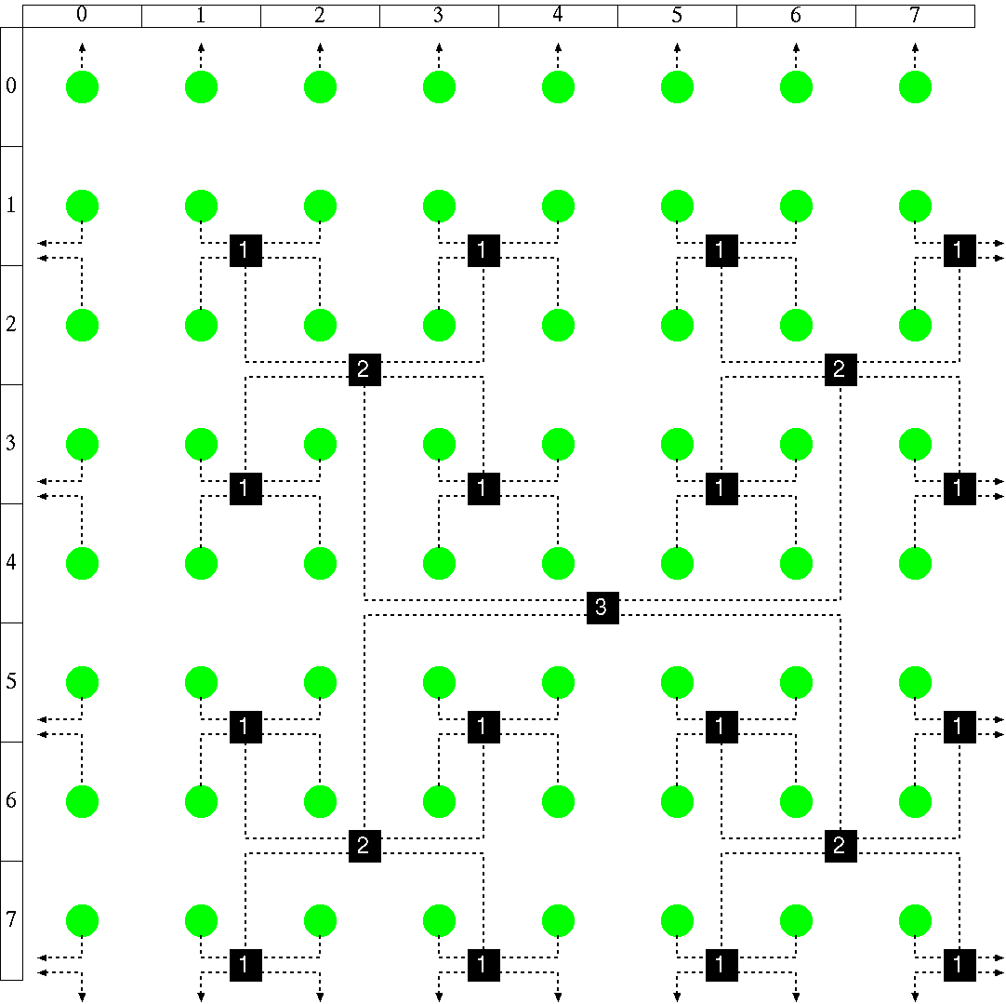
Fat H-Tree： A network topology for NoCs
Torus is formed
Each core connects to Red tree and Black tree
(※) routers for more than rank-2 are omitted
router, Core
router, Core
Notes:
Fat H Tree is also a network topology for NoCs, and combination of tree and mesh. However, exactly speaking it should be classified into indirect network.

Slide 44
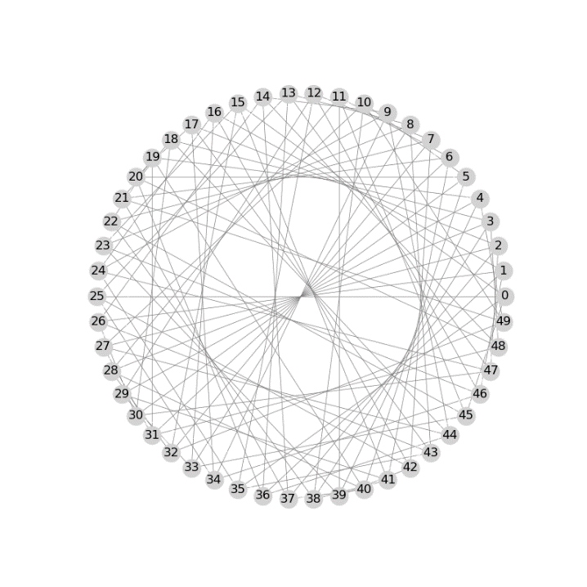
Slim Fly topology
Low diameter cost effective network
  Diameter is 2, semi-optimal
  Built with a limited size
3
(n=18, d=5)
(n=50, d=7)
[5] M. Besta and T. Hoefler: “Slim Fly: A Cost Effective Low-Diameter Network Topology”, SC’14.
Notes:
Slim fly topology is a cost effective low-diameter network. First, a group in which the hop is one is formed, and they are connected with each other. It can achieve the diameter 2, but only available with a limited size. It was proved to be semi-optimal from the viewpoint of graph theory.

Slide 45
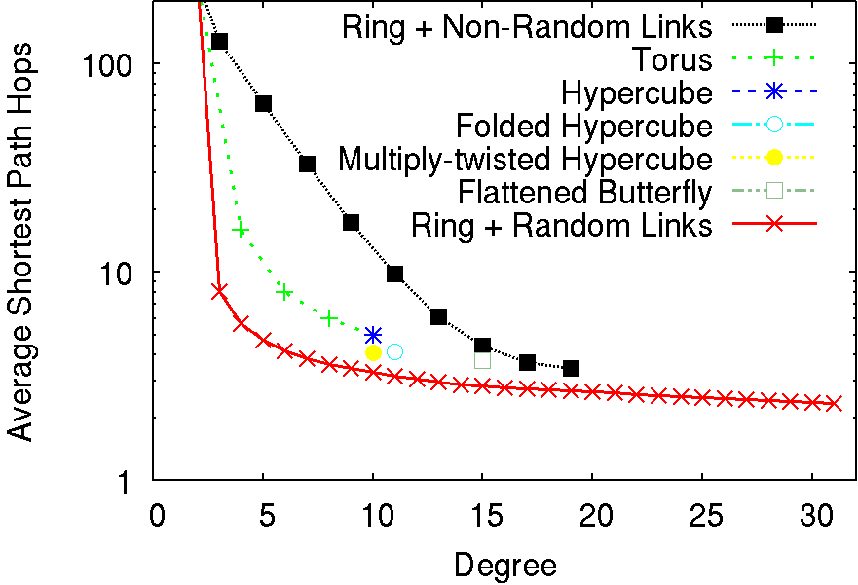
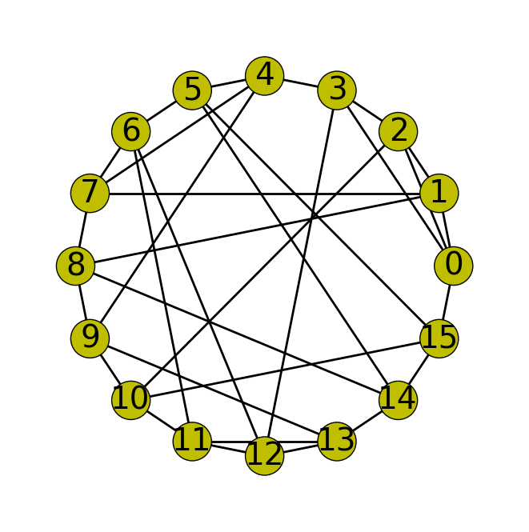
Random topologies
Regular networks
(Fat-tree, Torus)
Random Networks
Ring + Random Links
1,024 nodes
Hop reduction with small world effect
This slide was made by Dr. Kawano
Notes:
Recently random shortcut topologies have been researched.
As shown in the diagram, switches are connected with ring network and
randomly connected shortcut links.
With small world effect, the average shortest path hops are much reduced compared with regular networks.

Slide 46
Glossary 2
De Bruijin:人の名前でドブロイアンと読むのが本来の読み方だが英語圏の人はこれをデブルージンと読むので注意（最初全然わかんなかった）

Slide 47
Summary
k-ary n-cube has been used.
Efficient topologies from graph theory and random topologies attract attention.
  Graph Golf: http://research.nii.ac.jp/graphgolf/
Notes:
OK. Let’s summarize today’s lesson.

Slide 48
Exercise
Compute diameter of CCC with 16 cycles each of which has 4 nodes.
Hint: How is the method to move between cycles efficiently?
Notes:
Let’s try this exercise.

